Slide 1
INTERNAL METHODOLOGY · v0.1
Proposal Generation
Framework
How we built the Kingsford BMS proposal — a walkthrough of the agent-driven, tier-based pipeline.
PRESENTED BY
PILOT PROJECT
Rojel Rivera
Kingsford BMS · Megaworld

Slide 2
WALKTHROUGH
Agenda
01
The Challenge
07
Design Principles
Why we needed a new approach
Why the framework holds together
02
The Solution
08
Quality, Trust & Audit
A structured, agent-driven framework
Transparency and traceability
03
Tier 0 — Customer Inputs
09
Time Savings & Pilot Results
What we received
Before vs. after, Kingsford metrics
04
End-to-End Flow
10
v0 → Vision
The 10-phase sub-routine pipeline
Per-customer × per-discipline tracks
05
Tiers 1–4 — Working Documents
11
Next Steps
Agent interpretation → engineering basis
What we're asking the team to do
06
Tiers 6–8 — Costed BOQ & Deliverables
From line items to final files
Internal — Proposal Generation Framework
02 / 58

Slide 3
THE CHALLENGE
Proposals took too long, and quality was inconsistent
Pain points
Hidden costs
▸ Proposal preparation took 2–3 weeks per project, repeating much of the same work.
▸ Each estimator started from scratch, often with different assumptions.
▸ Junior staff had no structured framework to learn from.
▸ Customer asks 'where did this number come from?' — answer required digging through emails.
▸ No clear inventory of what we'd assumed vs. confirmed.
▸ Schedule estimates didn't reconcile with manpower didn't reconcile with cost.
▸ Each new project forgot the lessons of the last.
▸ Customer clarifications were missed, ad-hoc, or sent late.
Internal — Proposal Generation Framework
03 / 58

Slide 4
THE SOLUTION
Structured, agent-driven, tier-based
Each step is a sub-routine the AI agent follows; documents flow in tiers.
01
Two-layer separation
02
10 sequential phases
A reusable Master Playbook (sub-routines / agent instructions) plus a per-project workspace (working files).
Sub-routines cover everything from intake to deliverables.
03
Tier-based document organization
04
Working documents capture the basis
Tier 0 = customer inputs. Each generated tier reads only from lower tiers — strict DAG, no circular references.
Each tier exposes the engineering basis behind its numbers.
05
Mechanical + adaptive split
06
Standard formats are the contract
Helpers handle data aggregation between standardized formats; engineering judgment stays in agent instructions.
Canonical YAML schemas are what let the pipeline stay deterministic.
Internal — Proposal Generation Framework
04 / 58

Slide 5
0
TIER 0
What we received from the customer
Five documents, ~165 MB — the raw material the agent reads but never produces.
Internal — Proposal Generation Framework
05 / 58

Slide 6
TIER 0
The 5 Tier 0 documents
What the customer sent — the agent's input boundary.
Document
Source
What it tells us
Customer Enquiry Letter (Requirement.rtf)
Megaworld
Scope statement: complete supply, install, T&C of BMS.
BMS Points list (TUEC).pdf — 3 sheets, 22 MB
R.J. Calpo & Co.
BMS-01 spec + I/O tabulation; BMS-02 more I/O; BMS-03 P&IDs.
EE Plan (TUEC).pdf — 22 pages, 38 MB
Mario A. Alix Phils.
Construction Bulletin No. 8 — revised electrical layouts and load schedules.
MC Standards — ME Points List.pdf, 7 pp.
Megaworld portfolio standard
Mechanical points-list baseline (DOAS, AHU, EAS, BOH templates).
MC Standards — PL Points List.pdf, 1 p.
Megaworld portfolio standard
Plumbing points-list baseline (calorifiers, heat pumps, recirc pumps).
Internal — Proposal Generation Framework
06 / 58

Slide 7
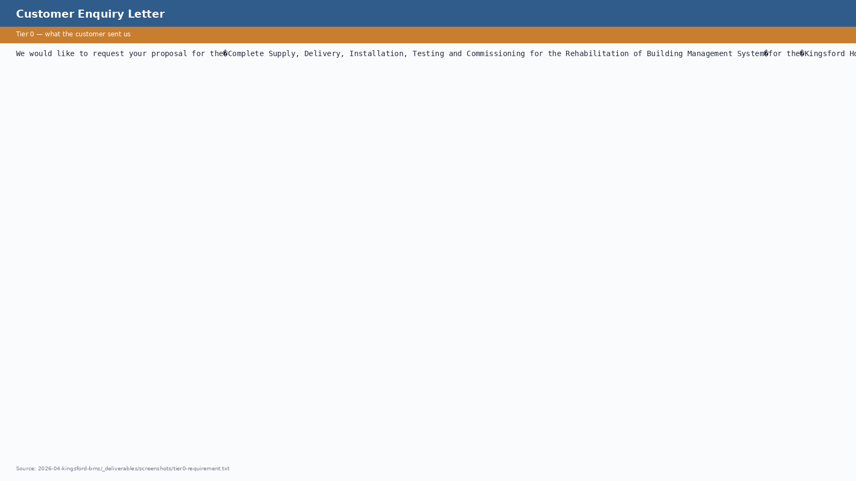
TIER 0
Customer Enquiry Letter (Requirement.rtf)
One-paragraph scope statement. Note the word 'Rehabilitation' — the trigger for our triangulation rule on stage classification.
Internal — Proposal Generation Framework
07 / 58

Slide 8
TIER 0
BMS Points list (TUEC), Sheet BMS-01
A1-format Construction Bulletin from R.J. Calpo & Co. — General BMS specifications and I/O tabulation per system.
Internal — Proposal Generation Framework
08 / 58

Slide 9
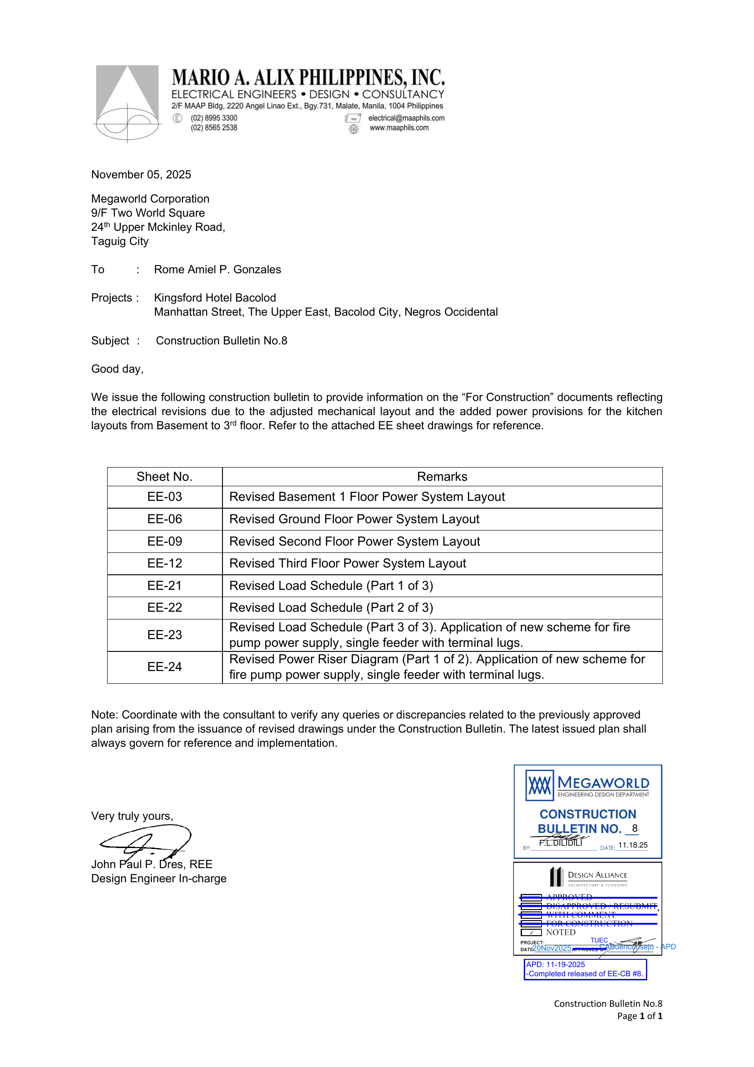
TIER 0
EE Plan (TUEC), Cover Letter
Construction Bulletin No. 8 cover from Mario A. Alix Phils. — adjusts mechanical layout and adds kitchen power provisions.
Internal — Proposal Generation Framework
09 / 58

Slide 10
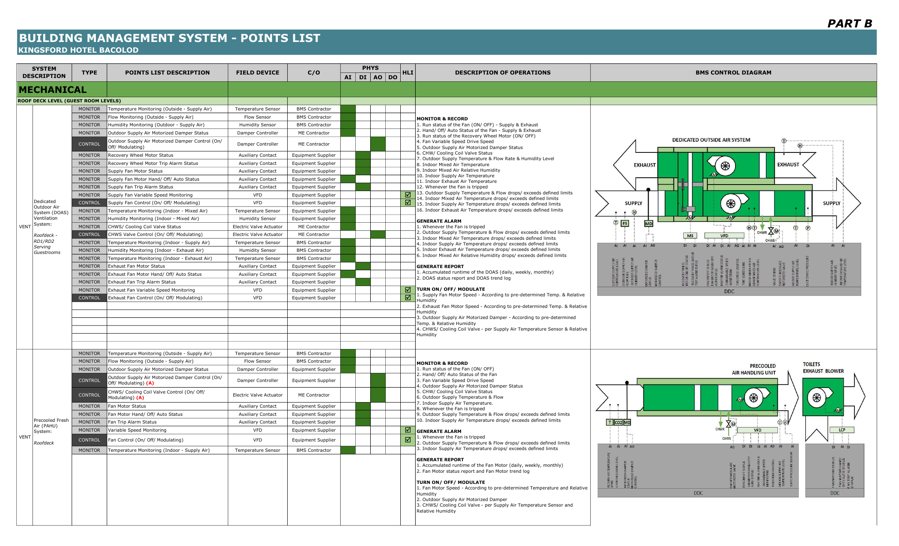
TIER 0
MC Standards — Mechanical Points List
Megaworld's CONDOTELS BMS standard for mechanical systems — applies as the baseline where the project-specific is silent.
Internal — Proposal Generation Framework
10 / 58

Slide 11
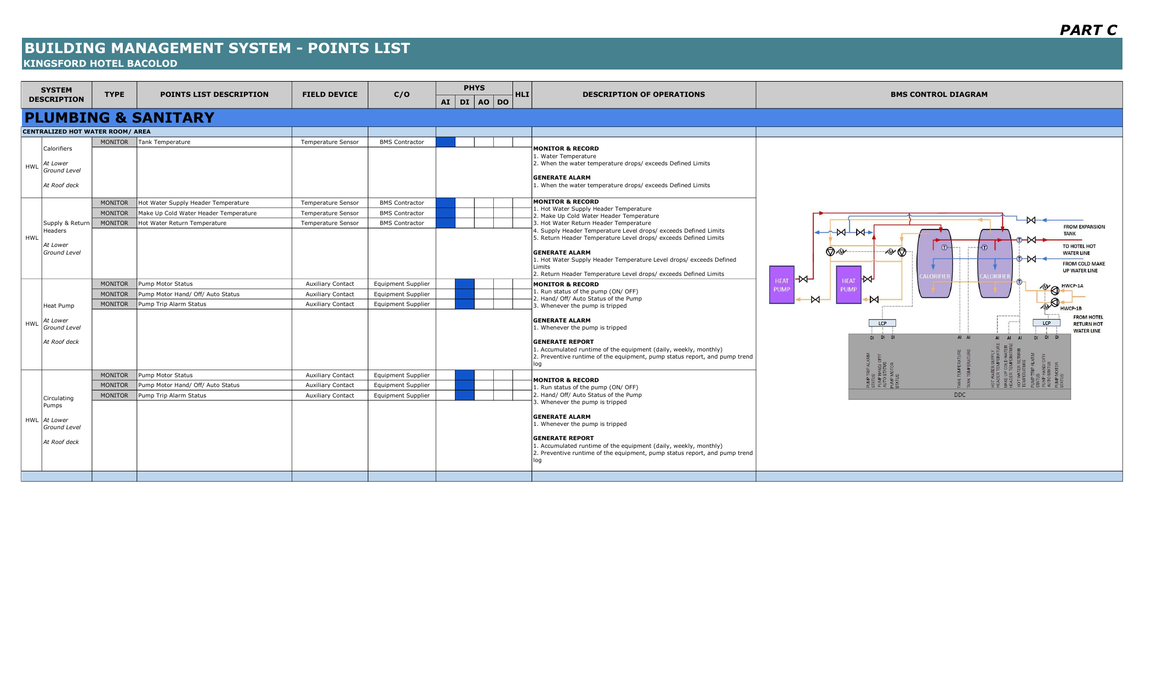
TIER 0
MC Standards — Plumbing Points List
Megaworld's CONDOTELS BMS standard for plumbing — calorifiers, heat pumps, recirculating pumps.
Internal — Proposal Generation Framework
11 / 58

Slide 12
THE PIPELINE
End-to-End Flow
Each box is a sub-routine. ◆ marks gates where the team validates before continuing.
TIER 0 — CUSTOMER INPUTS
Scope letter · Points list · Drawings · Standards
1
Intake
2
Classify
3
Doc Inventory
4
WBS
5a
Working Docs
Tier 1
Tier 1
Tier 1
Tier 2
Tiers 1-5
◆ GATE
5b
Scope Modules
6
BOQ
7
Assumptions
8
RFI
9
RFQ Package
Tier 4
Tier 6
Tier 5
Tier 5
Tier 7
◆ GATE
10
Proposal
TIER 8 — FINAL RENDERED DELIVERABLES
Tier 7
PDF · DOCX · Excel · PPTX · 13 customer-ready files from one command
Internal — Proposal Generation Framework
12 / 58

Slide 13
1
TIER 1
The agent's first interpretation
Documents produced directly from customer inputs — what the agent understands the project to be.
Internal — Proposal Generation Framework
13 / 58

Slide 14
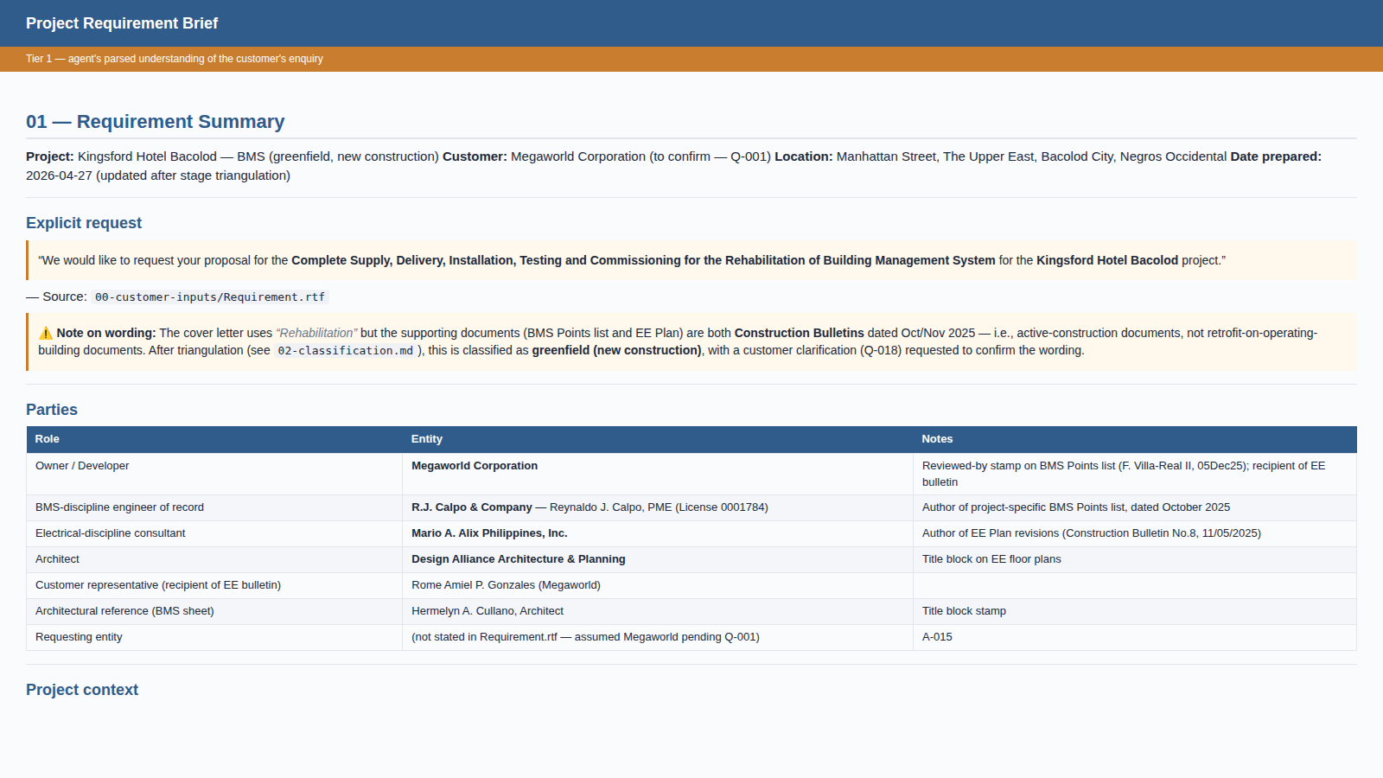
TIER 1
Project Requirement Brief
Generated from Tier 0 customer enquiry letter + supporting docs. The agent's parsed understanding of who, what, and where.
Internal — Proposal Generation Framework
14 / 58

Slide 15
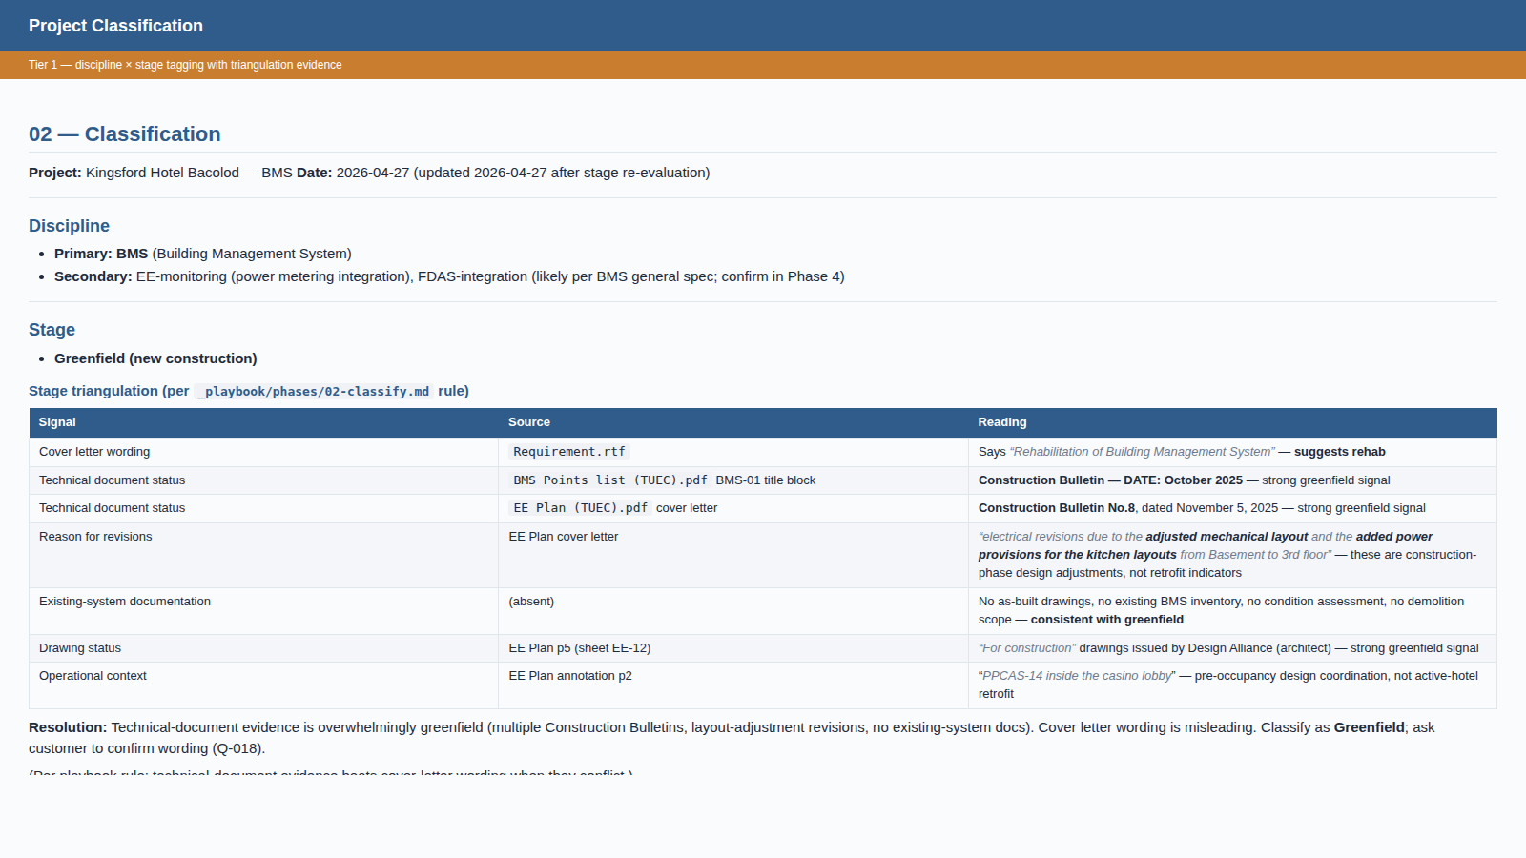
TIER 1
Project Classification (with triangulation evidence)
Discipline × stage tagging. Note the triangulation table: technical-document evidence (Construction Bulletins) overrides the cover letter's 'rehabilitation' wording.
Internal — Proposal Generation Framework
15 / 58

Slide 16
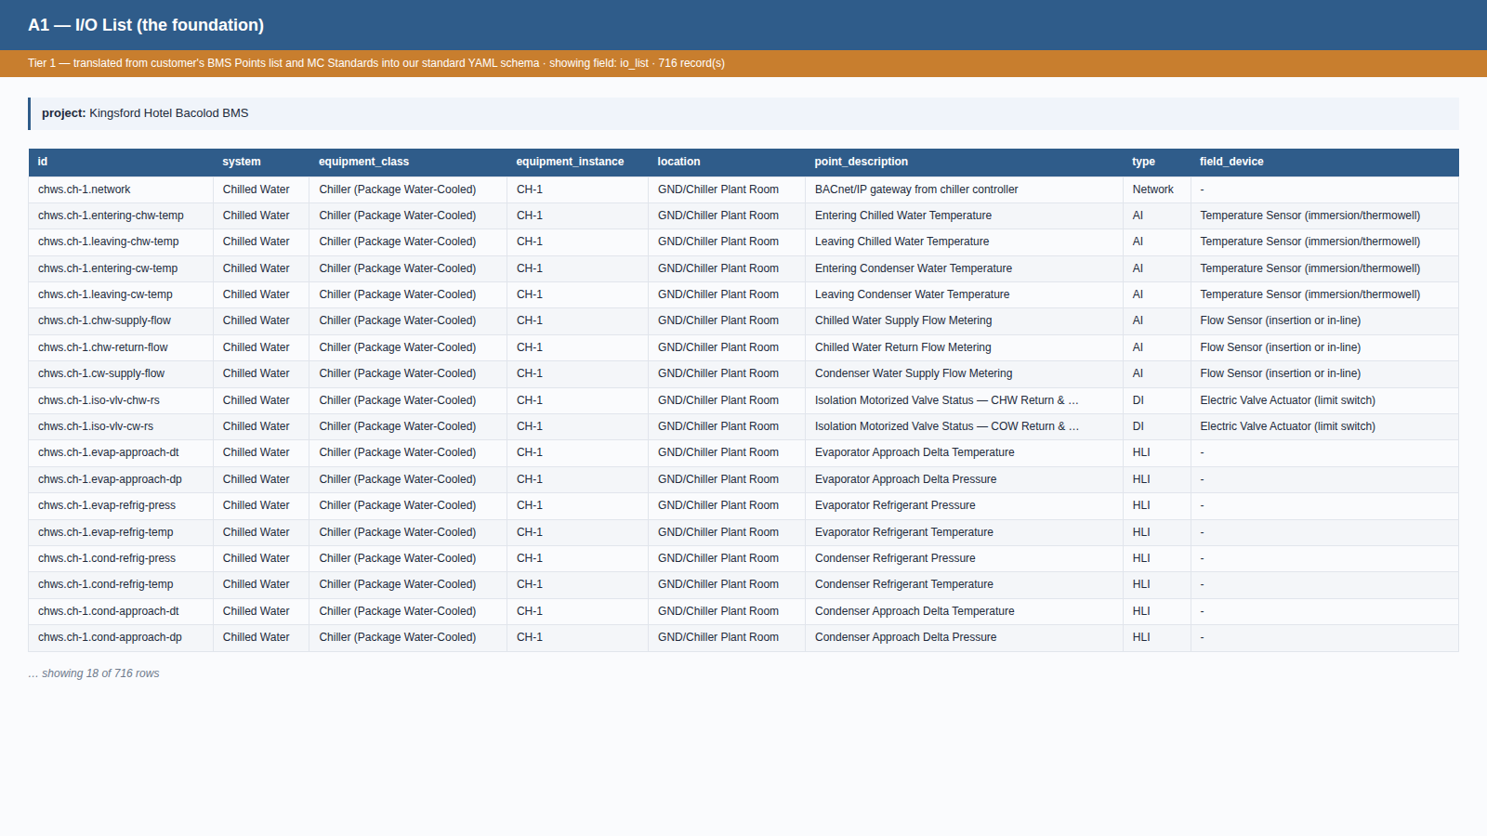
TIER 1
A1 I/O List — the foundation
Translated from BMS Points list + MC Standards into our standard YAML schema. 716 points; every row cites its source. Most downstream documents read from this.
Internal — Proposal Generation Framework
16 / 58

Slide 17
2
TIER 2
The engineering basis begins
WBS, applicability matrix, and the first round of derived working documents.
Internal — Proposal Generation Framework
17 / 58

Slide 18
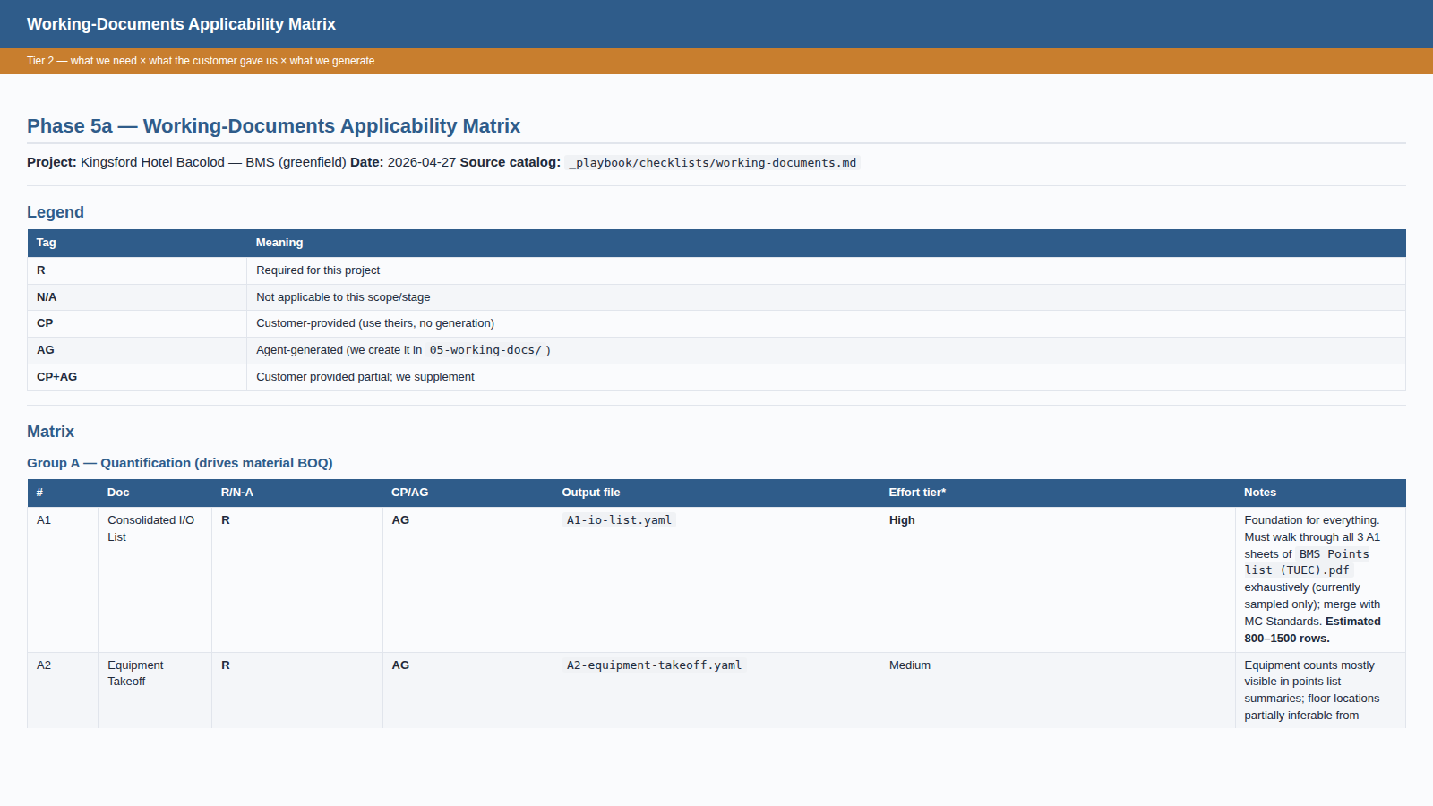
TIER 2
Working Documents Applicability Matrix
The agent's check-and-translate-and-generate plan. R/N-A × CP/AG/CP+AG marking for all 17 working-doc types.
Internal — Proposal Generation Framework
18 / 58

Slide 19
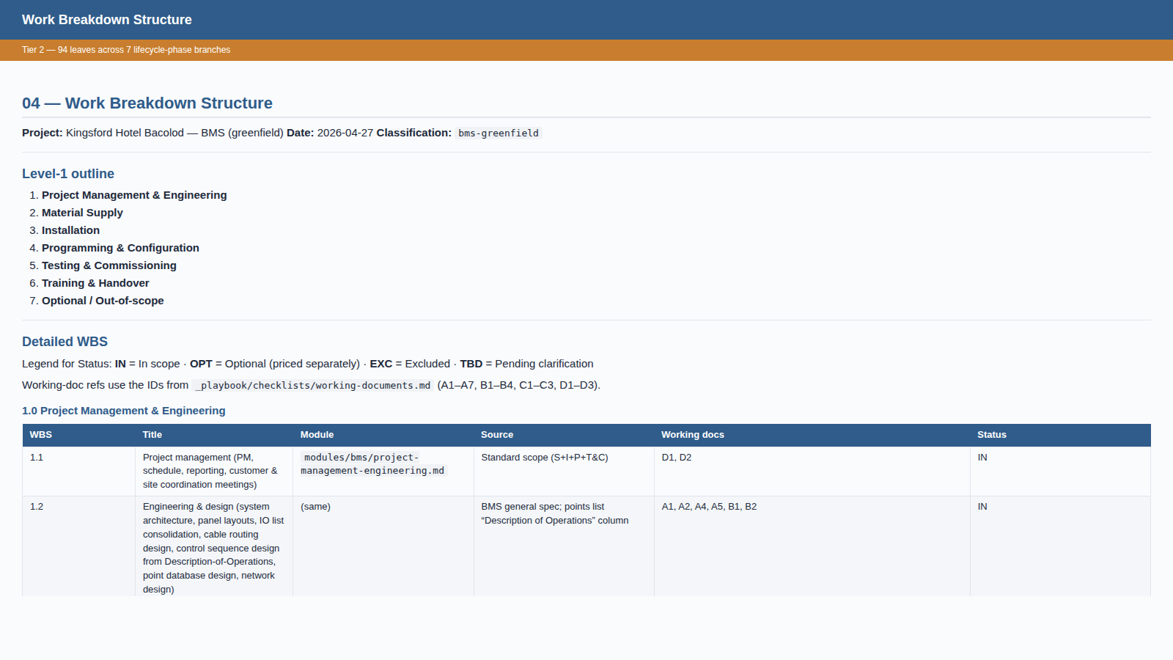
TIER 2
Work Breakdown Structure
94 leaves across 7 lifecycle-phase branches (PM, Supply, Install, Programming, T&C, Training, Optional). Each leaf cites a module template.
Internal — Proposal Generation Framework
19 / 58

Slide 20
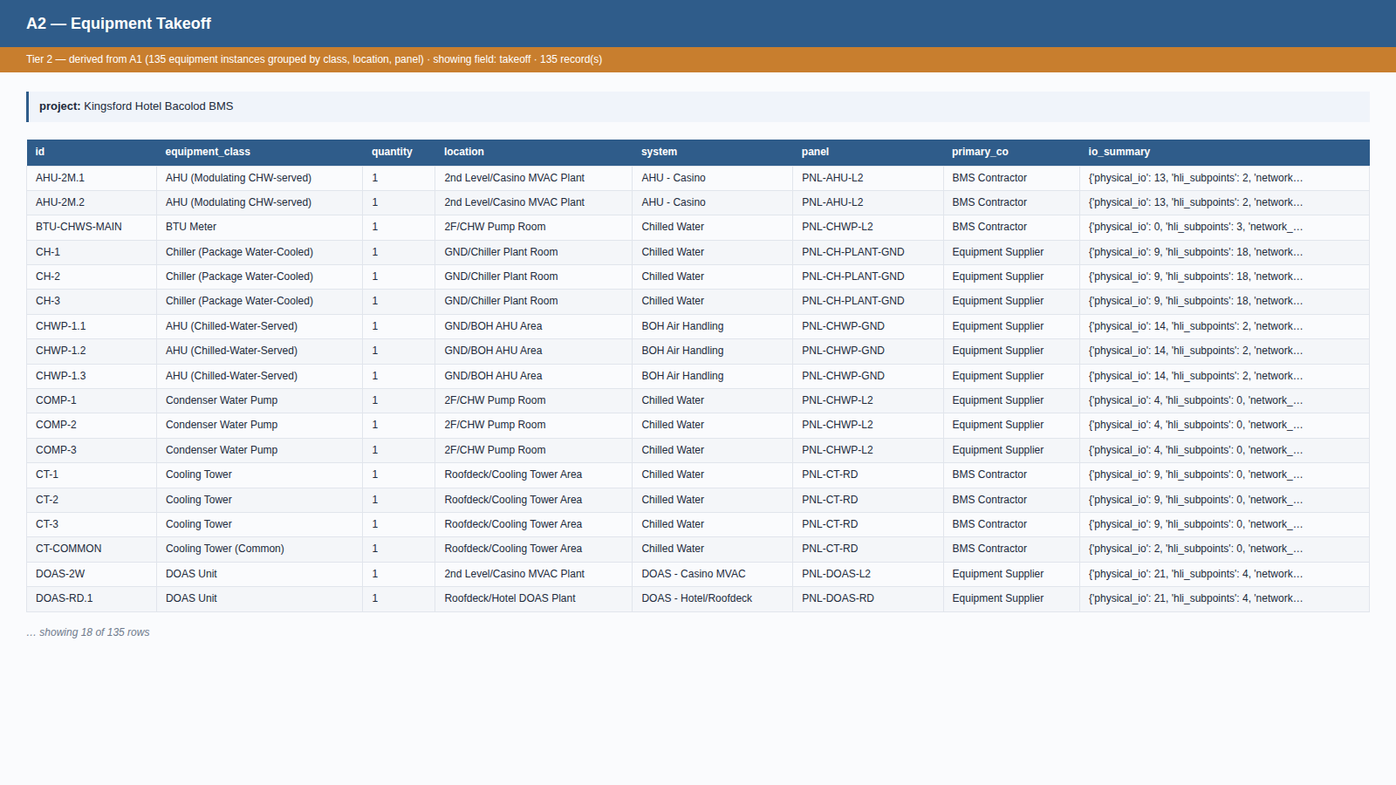
TIER 2
A2 — Equipment Takeoff
Auto-derived from A1: 135 equipment instances grouped by class, location, panel, and primary supplier.
Internal — Proposal Generation Framework
20 / 58

Slide 21
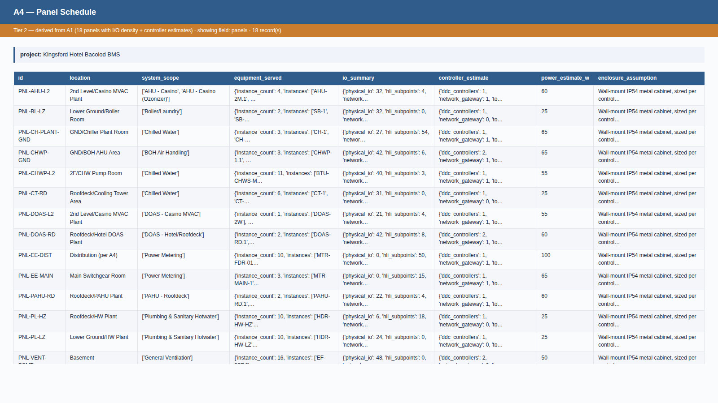
TIER 2
A4 — Panel Schedule
Auto-derived from A1: 18 BMS panels with I/O density, controller estimate, and power consumption.
Internal — Proposal Generation Framework
21 / 58

Slide 22
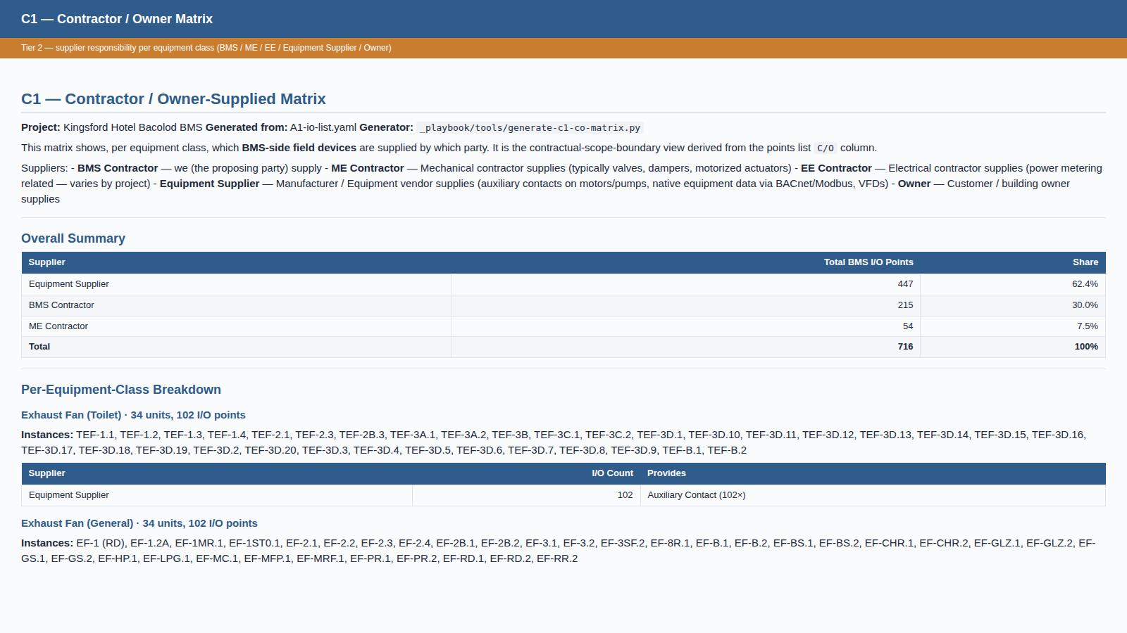
TIER 2
C1 — Contractor / Owner Matrix
Auto-derived from A1: per-equipment-class supplier responsibility — BMS / ME / EE / Equipment Supplier / Owner — with I/O counts.
Internal — Proposal Generation Framework
22 / 58

Slide 23
3
TIER 3
Derived working documents
Cable schedule, network architecture, commissioning inventory — built on Tier 2.
Internal — Proposal Generation Framework
23 / 58

Slide 24
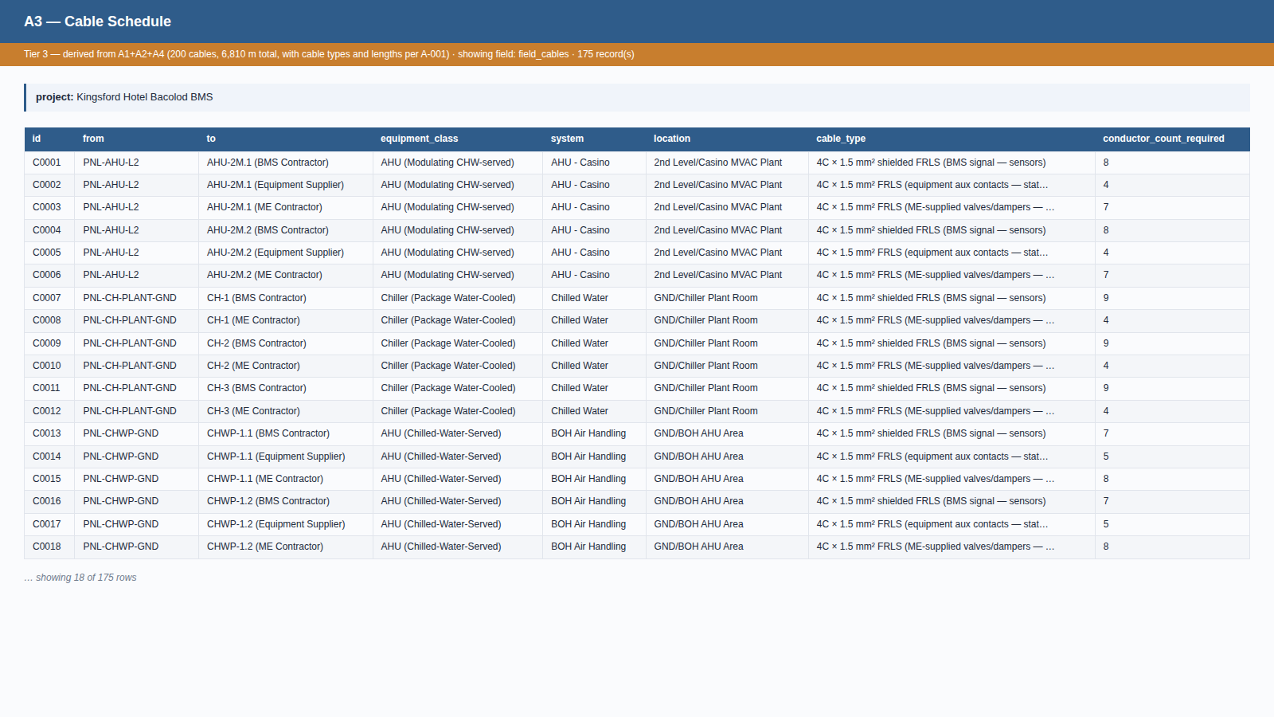
TIER 3
A3 — Cable Schedule
Auto-derived from A1+A2+A4 with cable-length assumption A-001. 200 cable runs; 6,810 m total.
Internal — Proposal Generation Framework
24 / 58

Slide 25
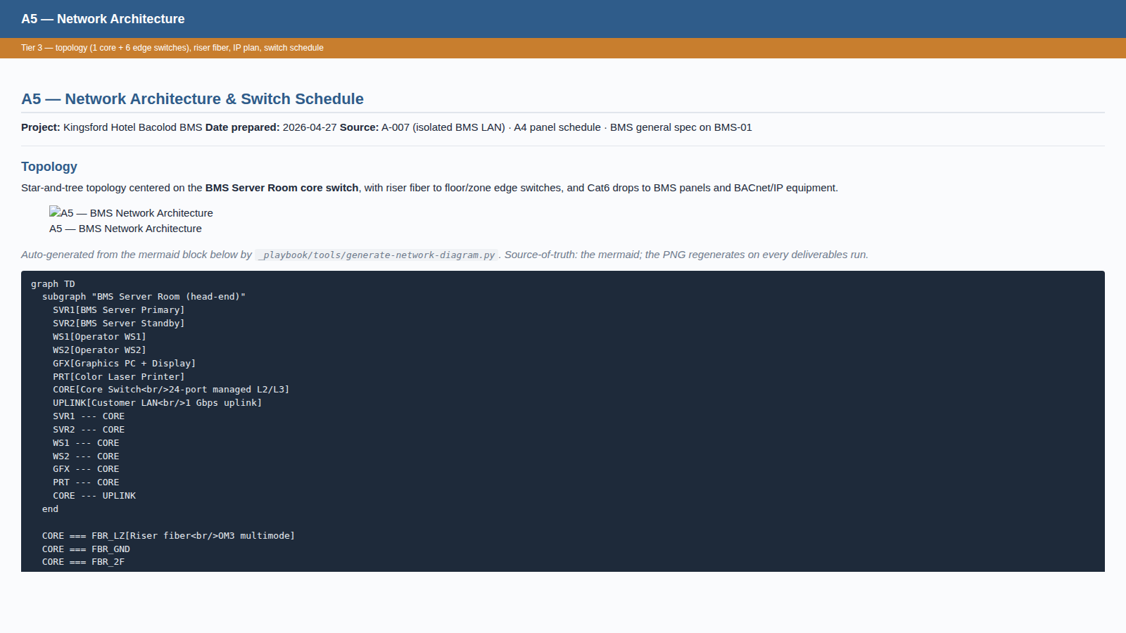
TIER 3
A5 — Network Architecture (working doc)
Hand-curated topology and switch schedule. 1 core + 6 edge switches, OM3 fiber backbone, flat /24 IP plan.
Internal — Proposal Generation Framework
25 / 58

Slide 26
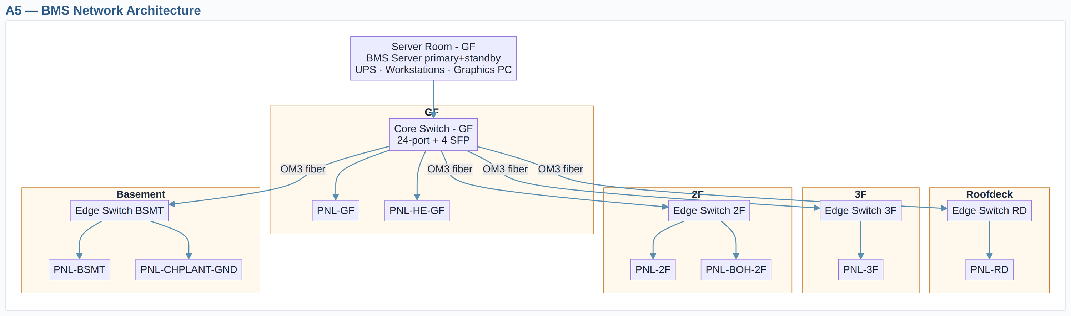
TIER 3
A5 — Network Architecture
Auto-rendered from the A5 mermaid block. Star-and-tree centred on the core switch; riser fiber to per-floor edge switches; BACnet/IP equipment direct to the floor switch. Single horizontal output used for both proposal PDF and slides.
Internal — Proposal Generation Framework
26 / 58

Slide 27
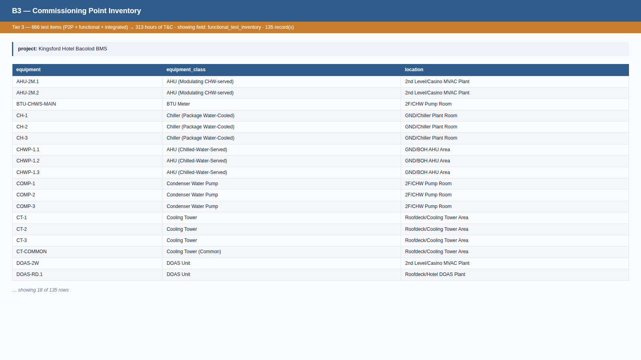
TIER 3
B3 — Commissioning Point Inventory
Auto-derived from A1+A2: every physical I/O for P2P, every equipment for functional tests, plus 8 cross-system integrated sequences. 313 hours of T&C.
Internal — Proposal Generation Framework
27 / 58

Slide 28
4
TIER 4
Integrated outputs and scope modules
Manpower, schedule, risks, and the 11 scope-module instances.
Internal — Proposal Generation Framework
28 / 58

Slide 29
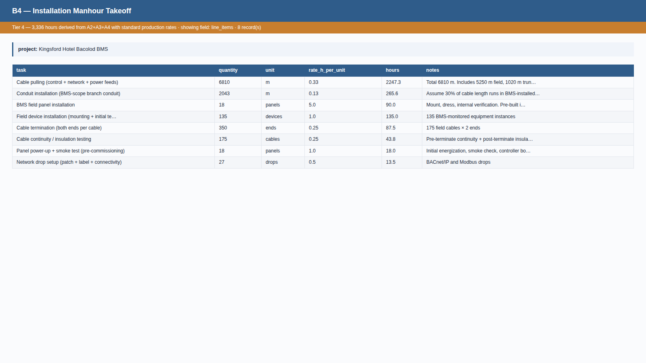
TIER 4
B4 — Installation Manhour Takeoff
Auto-derived from A2+A3+A4 using standard production rates. 3,336 hours installation labor; 417 person-days.
Internal — Proposal Generation Framework
29 / 58

Slide 30
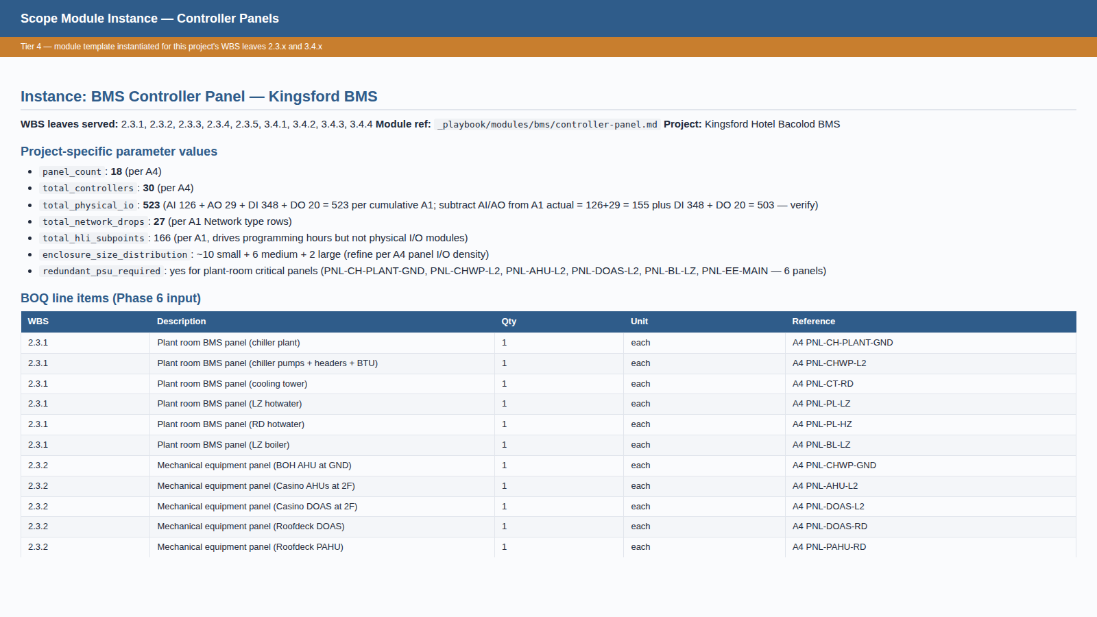
TIER 4
Scope Module Instance — Controller Panels
One of 11 scope modules instantiated for Kingsford. Module template + project-specific parameters → BOQ-ready line items.
Internal — Proposal Generation Framework
30 / 58

Slide 31
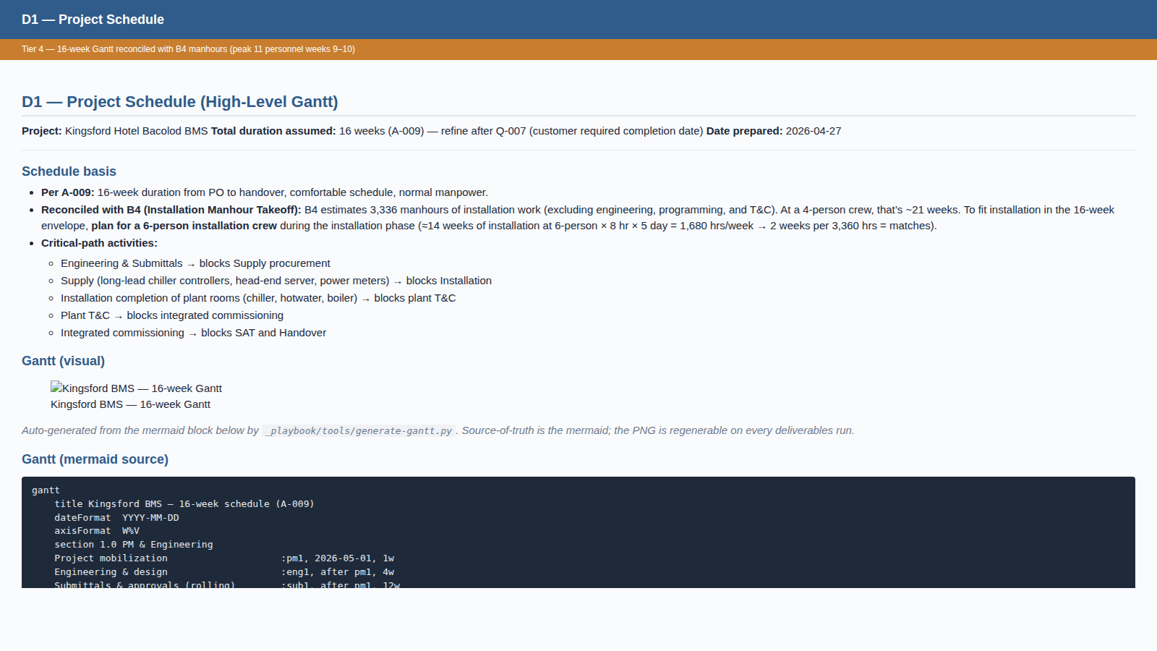
TIER 4
D1 — Project Schedule
Internal — Proposal Generation Framework
31 / 58

Slide 32
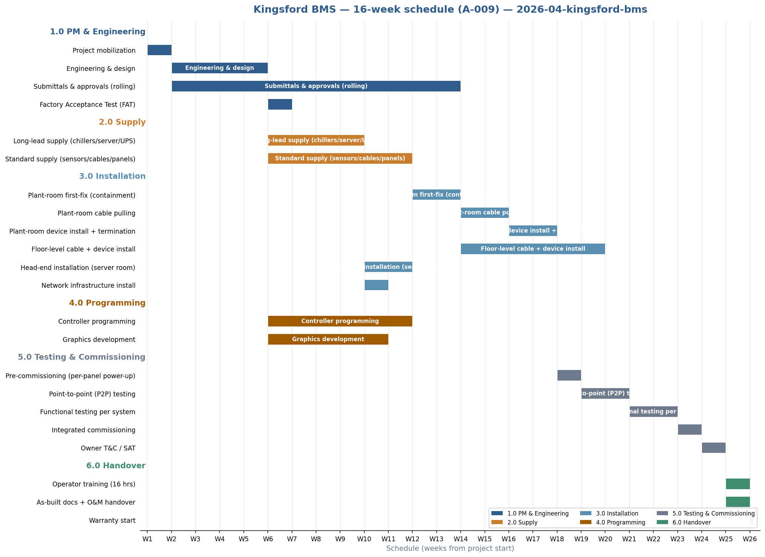
TIER 4
D1 — Project Schedule (visual Gantt)
Auto-generated from the D1 schedule. Sections colour-coded by lifecycle phase; milestones shown as diamonds.
Internal — Proposal Generation Framework
32 / 58

Slide 33
6
TIER 6
Bill of Quantities — the costed output
86 line items aggregated from working docs + pricing rate library — PHP 21.98 M grand total.
Internal — Proposal Generation Framework
33 / 58

Slide 34
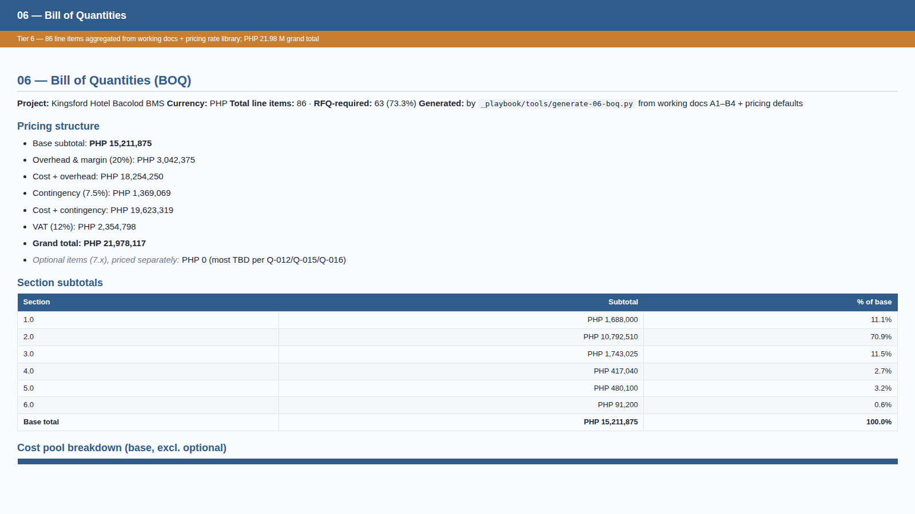
TIER 6
Bill of Quantities
Mechanical aggregation: the BOQ generator reads working docs A1–B4 and applies the pricing rate library. Every line cites its source.
Internal — Proposal Generation Framework
34 / 58

Slide 35
7
TIER 7
Customer-facing synthesis
The proposal narrative + supplier RFQ package.
Internal — Proposal Generation Framework
35 / 58

Slide 36
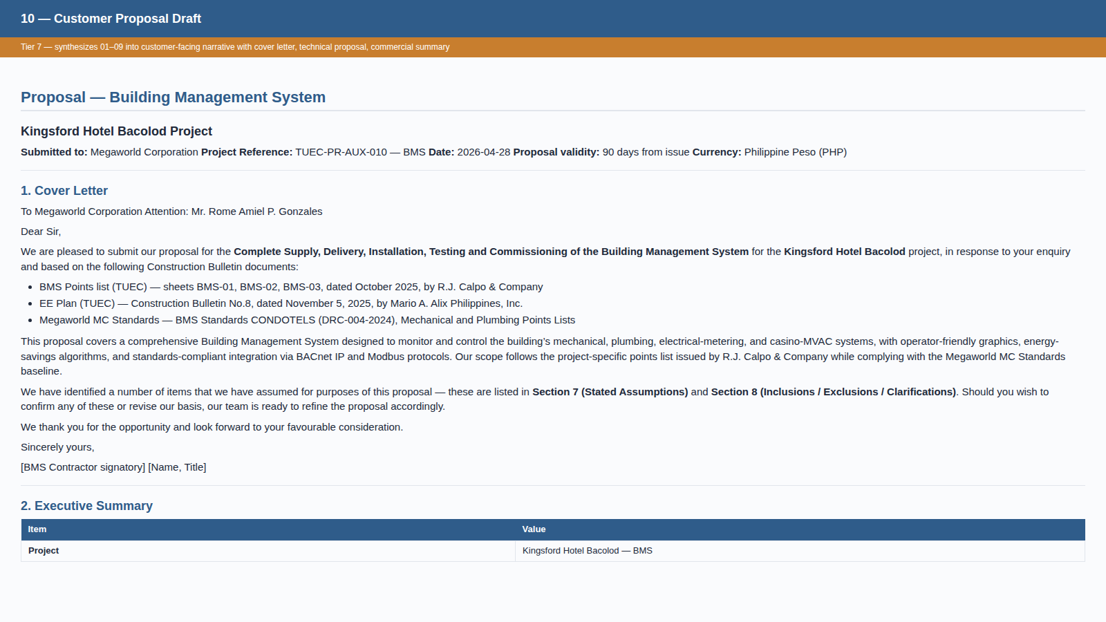
TIER 7
Customer Proposal Draft
Internal — Proposal Generation Framework
36 / 58

Slide 37
8
TIER 8
Final rendered deliverables
13 customer-ready files produced from a single command.
Internal — Proposal Generation Framework
37 / 58

Slide 38
TIER 8 — DELIVERABLES
Final Rendered Deliverables Package
Mechanical helpers render Tier 7 markdown / YAML into PDF · DOCX · Excel · PPTX.
File
Format
Size
Pages / Sheets / Slides
01 — Initial Overview
PDF
80 KB
7 pages
02 — Proposal Draft
PDF
239 KB
30 pages
03 — BOQ (Bill of Quantities)
Excel
29 KB
11 sheets
04 — A1 I/O List
Excel
51 KB
2 sheets
05 — A2 Equipment Takeoff
Excel
18 KB
2 sheets
06 — A3 Cable Schedule
Excel
20 KB
4 sheets
07 — A4 Panel Schedule
Excel
10 KB
3 sheets
08 — Open Items / RFI
Word
15 KB
—
09 — Stated Assumptions
Word
16 KB
—
10 — Proposal (Comprehensive)
PDF + DOCX
1.5 MB
92 pages
11 — Customer Proposal Presentation
PowerPoint
74 KB
31 slides
12 — Internal Methodology Presentation
PowerPoint
70 KB
this deck
Internal — Proposal Generation Framework
38 / 58

Slide 39
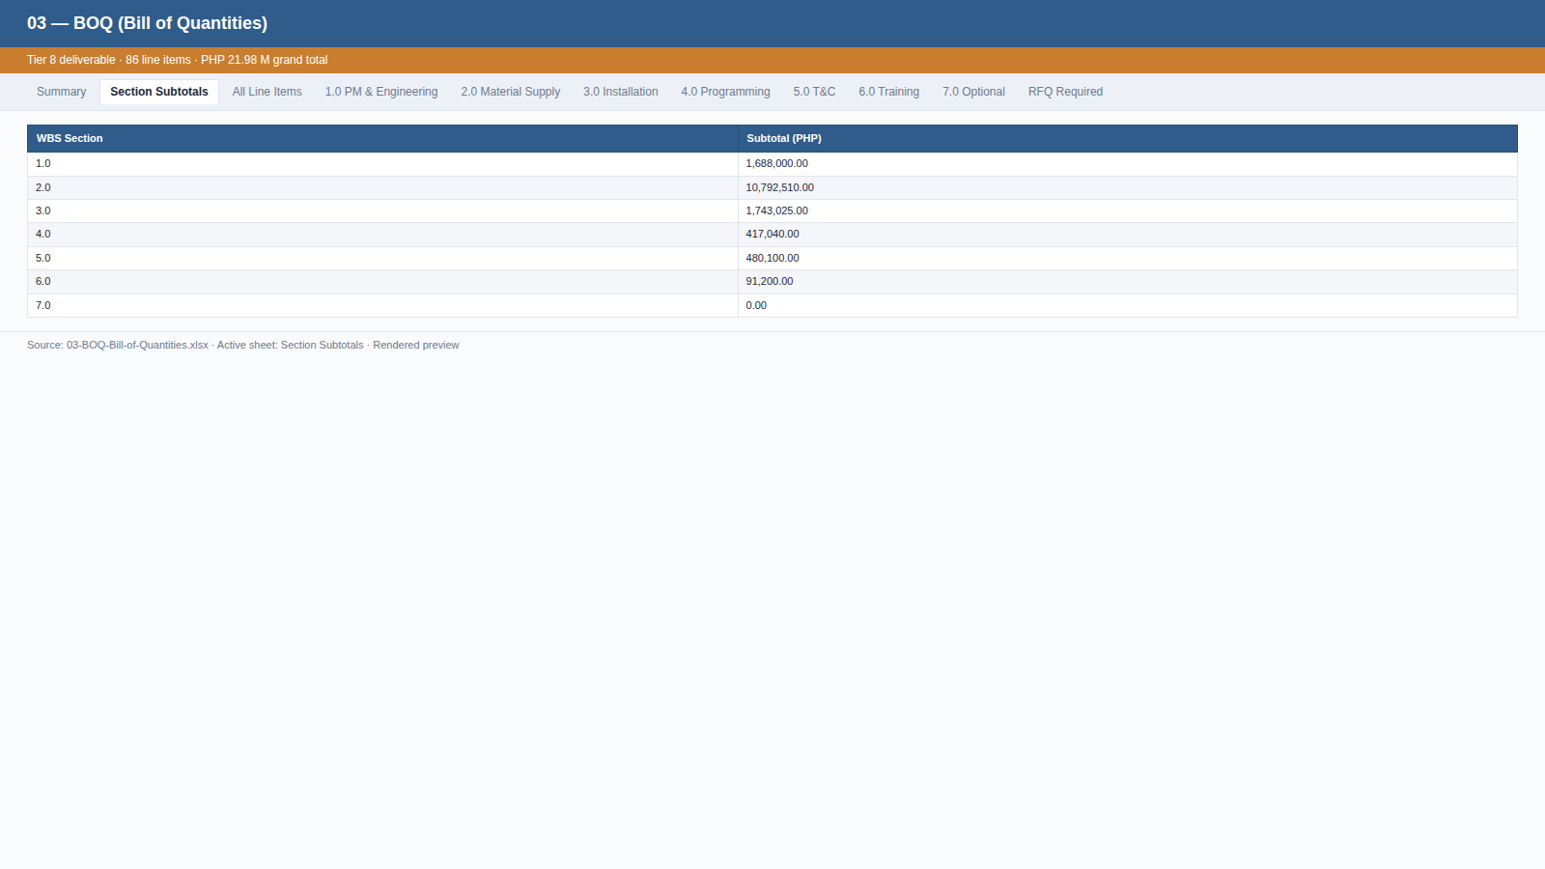
TIER 8
BOQ — Section Subtotals
The Excel file the team opens. Multi-sheet workbook — Summary, Section Subtotals, All Line Items, per-WBS sheets, RFQ Required filter. PHP 21.98 M grand total.
Internal — Proposal Generation Framework
39 / 58

Slide 40
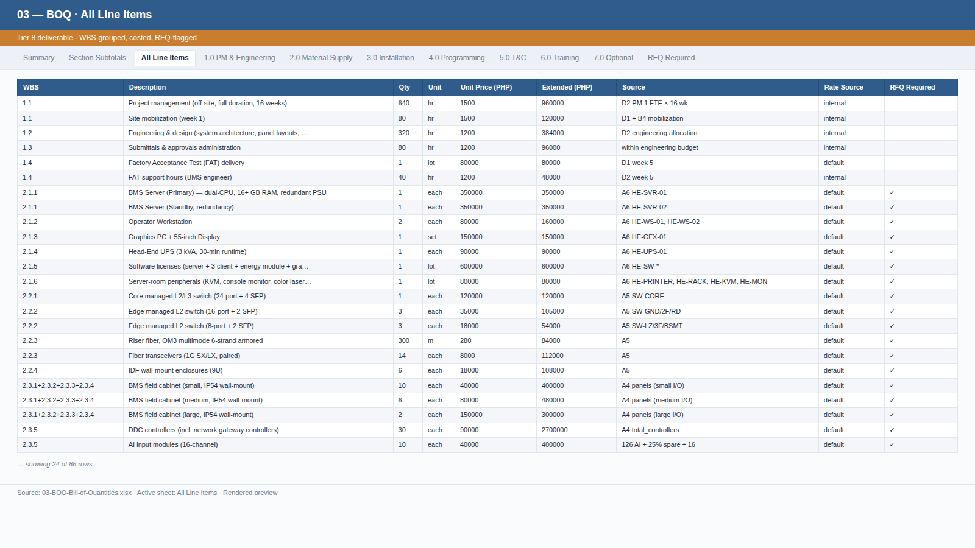
TIER 8
BOQ — All Line Items
86 costed line items, WBS-grouped, RFQ-flagged. Every quantity traces to a working doc; every rate to the pricing rate library.
Internal — Proposal Generation Framework
40 / 58

Slide 41
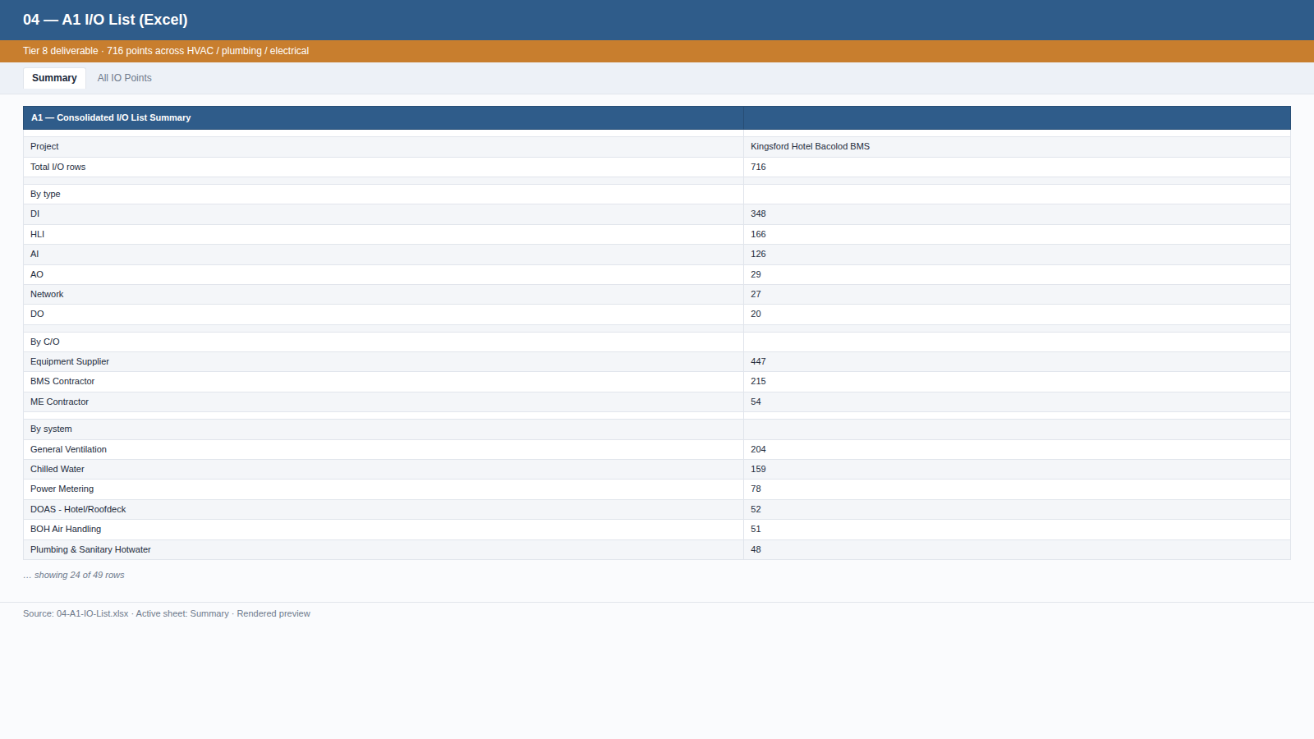
TIER 8
A1 — I/O List (Excel)
716 points across HVAC / plumbing / electrical, with system / equipment / location / panel / point description / type / source.
Internal — Proposal Generation Framework
41 / 58

Slide 42
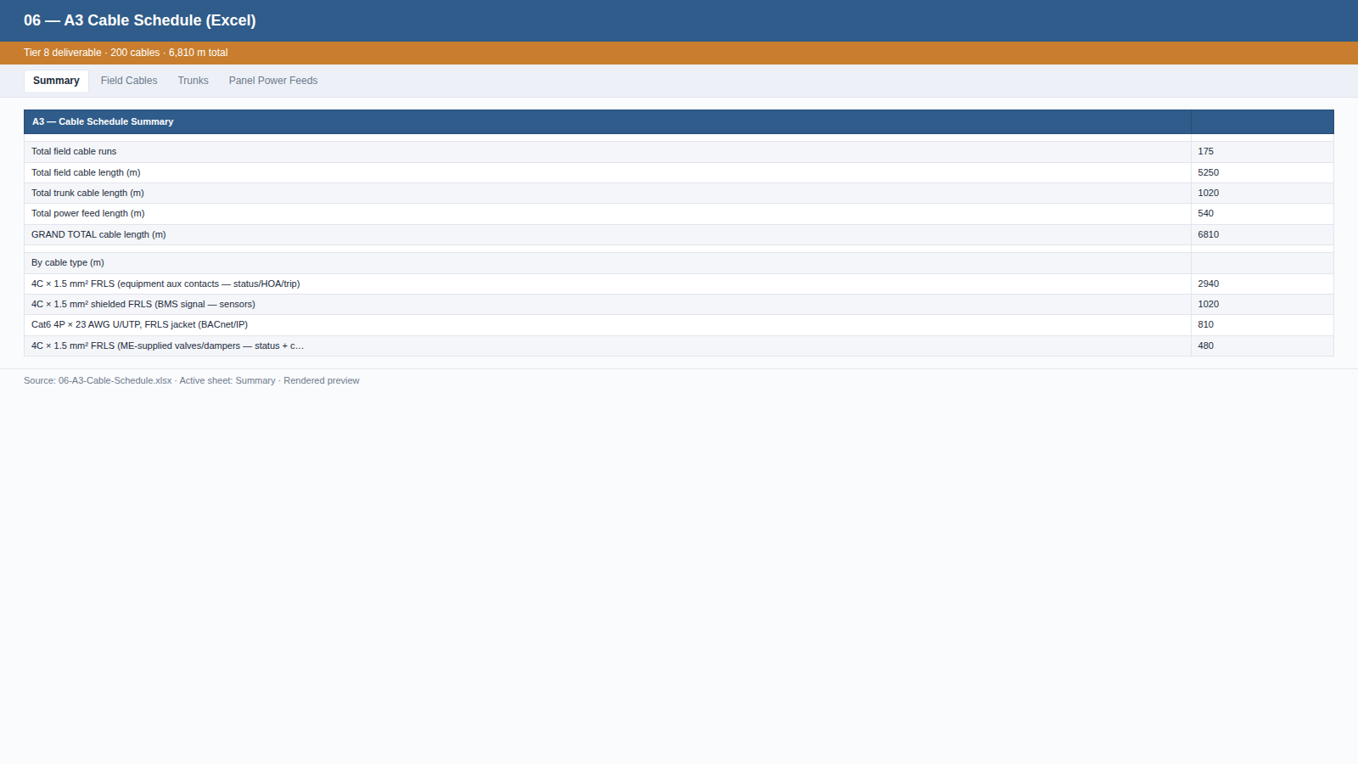
TIER 8
A3 — Cable Schedule (Excel)
200 cables, 6,810 m total. From / To / cable type / length / source — sortable, filterable by panel / floor.
Internal — Proposal Generation Framework
42 / 58

Slide 43
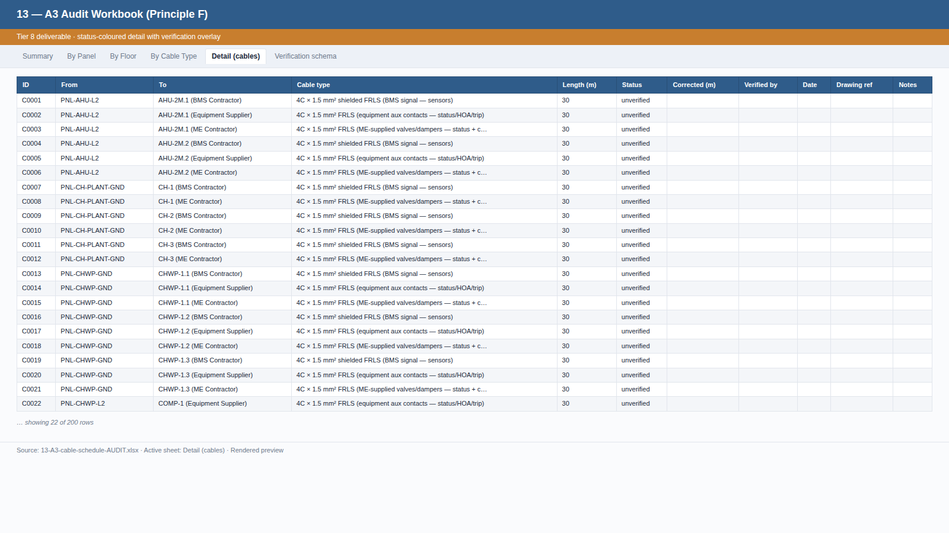
TIER 8
A3 — Audit Workbook (Principle F)
Per-cable Detail with status-coloured cells (green / red / yellow / grey) — auto-filter so the team can isolate unverified rows for site walkthroughs.
Internal — Proposal Generation Framework
43 / 58

Slide 44
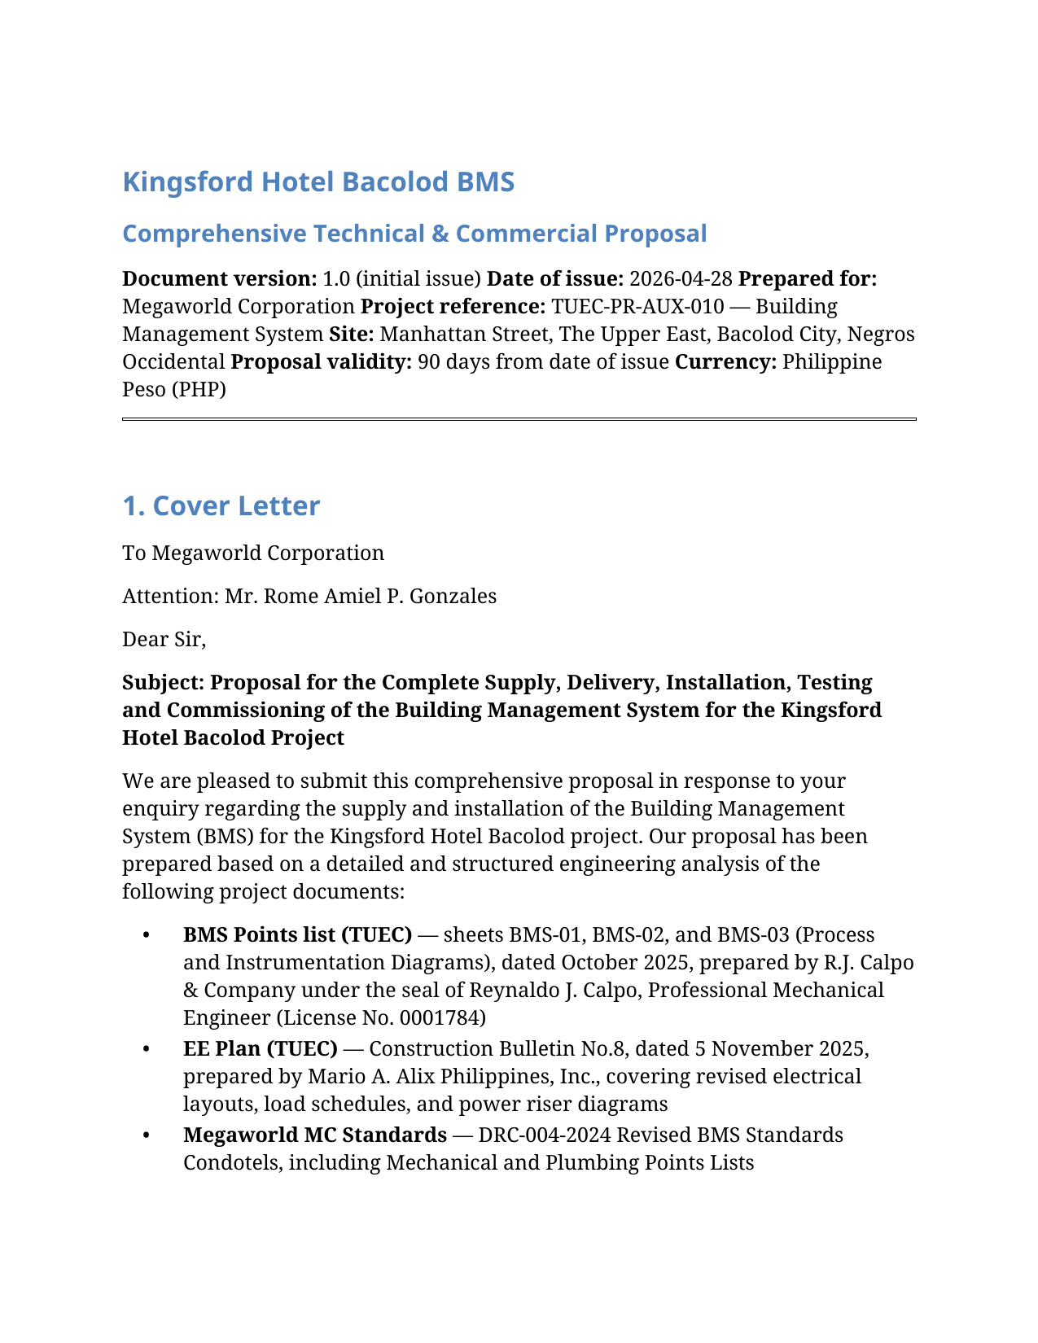
TIER 8
Comprehensive Proposal — PDF cover page
The customer-facing PDF (~92 pages): cover letter, executive summary, technical proposal, schedule, commercial summary, stated assumptions, inclusions/exclusions.
Internal — Proposal Generation Framework
44 / 58

Slide 45
PRINCIPLES
Why the framework holds together
Five design principles that govern every project.
Internal — Proposal Generation Framework
45 / 58

Slide 46
PRINCIPLES
Design Principles A–F
These principles govern when to extend the framework and what to keep adaptive.
A
Mechanical helpers operate only on standardized data
B
Engineering judgment lives in agent instructions
C
The applicability check is foundational
Customer-document interpretation stays adaptive — in agent instructions.
Agent CAN write project-specific helpers; permanent tools are mechanical.
Phase 5a always begins with 'what we need vs. what's given'.
D
Determinism through standard formats
E
Document tier classification (the dependency DAG)
F
Transparency and auditability — never hide weak spots
Customer docs are translated to a canonical format BEFORE downstream work.
Strict tier ordering; no circular references; build order is known.
Auto-generated quantities the team must verify get an overlay + sibling audit workbook.
Internal — Proposal Generation Framework
46 / 58

Slide 47
PRINCIPLE D
Determinism through standard formats
Standard formats are the contract that lets mechanical helpers run reliably.
Standard formats — the contract
Translation at the entry boundary
▸ Every working-doc type has ONE canonical format.
▸ I/O list — standard YAML schema (id, system, equipment, location, point, type, field device, C/O, source, …).
▸ BOQ — standard YAML schema (line items with WBS, qty, unit, rate, source, RFQ flag).
▸ Cable, panel, equipment takeoff — each has a single canonical format.
▸ Pricing rate library + equipment-class defaults — standard YAML, peer-reviewable.
▸ Agent transcribes customer docs into our standard format BEFORE proceeding.
▸ Each translated row cites the customer's source file for traceability.
▸ Schema mismatches surface as assumptions and clarifications.
▸ Downstream work always operates on the standardized representation, never on the customer's native format.
▸ Result: regardless of customer format variation, the downstream pipeline stays deterministic.
Internal — Proposal Generation Framework
47 / 58

Slide 48
WHERE AUTOMATION ENDS AND JUDGMENT BEGINS
Mechanical vs. agent-driven
We're conservative about what we automate.
Mechanical (Python helpers)
Agent-driven (sub-routines / instructions)
▸ Pure data aggregators on standardized YAML — no customer-document interpretation.
▸ BOQ aggregator · RFQ packager · Excel exporters · PDF / DOCX rendering · Presentation builders.
▸ Why safe: input/output formats are fixed, every quantity is sourced from agent-prepared data.
▸ Adaptive instructions in the playbook — sub-routines the agent follows.
▸ Customer document extraction protocol · project classification (triangulation) · required-doc checklist comparison.
▸ WBS scope decomposition · working-document applicability matrix · interpreting points list into I/O list.
▸ Module instance parameter selection · assumption rationale · customer clarification framing.
▸ When format/scope is genuinely unique, the agent writes a project-specific helper script.
Internal — Proposal Generation Framework
48 / 58

Slide 49
PRINCIPLE F
Transparency & auditability layer
Some auto-generated quantities are inherently soft. We don't pretend; we make them visible and editable.
The honest framing
The mechanism
▸ The named weakest spot: cable lengths.
▸ Today the agent uses assumption A-001 — 30 m average panel-to-device run, 80 m trunk per floor — because we don't always have scaled drawings or a site walkthrough yet.
▸ Field-verified lengths typically vary ±20% per cable.
▸ If we hide that, the BOQ looks more confident than it is.
▸ The fix: a transparency layer that makes weak spots obvious and editable — not buried in a YAML footnote.
▸ Every team-verifiable working doc (A1, A2, A3, A4, A6, B4, D1) supports a verification: overlay block per row — status / corrected_<field> / verified_by / drawing_ref / notes.
▸ Mechanical helpers respect the corrected value when present — corrections flow into B4 manhours, BOQ, and final deliverables automatically.
▸ A sibling Excel audit workbook is generated alongside each YAML — that's the team's review surface.
▸ Audit workbook is regenerable; canonical YAML is the single source of truth.
Internal — Proposal Generation Framework
49 / 58

Slide 50
AUDIT WORKBOOK
What the team actually opens
XLSX, multi-sheet, filterable. Built for how the proposal team works in Excel daily.
What's in the workbook
How the team uses it
▸ Summary — totals, status counts (colour-coded), known weak points, correction workflow.
▸ Per-axis rollups — e.g., A3 cable schedule has By Panel / By Floor / By Cable Type.
▸ Detail — every row with auto-filter + frozen header; status cells colour-coded (green = verified, red = needs correction, yellow = uncertain, grey = unverified).
▸ Verification schema — copy-pasteable YAML template + priority-ordered verification methods.
▸ At desk: open A3-cable-schedule-AUDIT.xlsx, filter Detail by panel, cross-check totals against architectural drawings.
▸ On site: print or open on tablet, walk the building, mark up.
▸ Back at desk: edit A3-cable-schedule.yaml — add a verification: block with corrected_length_m, status, drawing_ref.
▸ Re-run the deliverables generator — corrections propagate.
Internal — Proposal Generation Framework
50 / 58

Slide 51
WHERE THIS IS GOING
The proposal cockpit (v1+)
v0 surfaces ask the user to think like the agent. The cockpit inverts that.
Where we are — v0
Where we're going — v1+ journey-style UX
▸ Customer drops files in a folder.
▸ Agent runs in a terminal.
▸ Outputs land as XLSX / PDF / DOCX.
▸ Verification = open Excel + edit YAML.
▸ Honest, but technical. The user has to think in our shapes.
▸ Drop-zone intake — drag-and-drop with auto-classified document tiles.
▸ One "Generate proposal" button — live phase-by-phase progress.
▸ Tier walk — visual timeline Tier 0 → Tier 8, click any node to inspect lineage.
▸ Audit cockpit — split-pane: drawing left ~70%, filterable row list right ~30%; click a row, drawing pans to grid reference; inline-edit writes back to YAML.
▸ Regen loop — one button refreshes downstream artifacts; diffs are visible per phase.
Internal — Proposal Generation Framework
51 / 58

Slide 52
QUALITY & TRUST
Why this approach is defensible and auditable
Every claim in the proposal can be traced to a source.
✓
Every quantity is traceable
✓
Assumptions are explicit
Each BOQ line cites its working doc; each working doc cites the customer's source document.
19 stated assumptions in the proposal, each with cost-impact-if-wrong.
✓
The basis is reproducible
✓
No hidden magic in labor / rates
Re-run the aggregators and the same input produces the same output.
Pricing defaults are a peer-reviewable rate library.
✓
Customer questions have documented answers
✓
Audit trail
Each clarification has a default assumed and a rationale.
Every change committed with a 'why' message.
✓
Deliverables are internally consistent
BOQ in the PDF = BOQ in the Excel = BOQ in the proposal narrative.
Internal — Proposal Generation Framework
52 / 58

Slide 53
IMPACT
Time Savings — Before vs. After
What used to take 2–3 weeks now takes 5–7 working days.
Phase
Before (hand-rolled)
After (this framework)
Why
Phases 1–4: Intake → WBS
2–3 days
1 day
with structured walkthrough
Phase 5a: Working documents
5–7 days
2–3 days
~half are auto-aggregated
Phase 5b: Module instantiation
Skipped
0.5 day
templates
Phase 6: BOQ
2–3 days
Hours
one command
Phases 7–8: Assumptions + RFI
Ad-hoc
Hours
auto-organized
Phase 9: RFQ to suppliers
Manual
Hours
12 docs auto-categorized
Phase 10: Proposal narrative
3–5 days
1 day
templates + auto-populate
TOTAL TYPICAL
2–3 weeks
5–7 working days
≈ 60% time reduction
Internal — Proposal Generation Framework
53 / 58

Slide 54
PILOT RESULTS
Kingsford BMS — What We Produced
From 5 customer documents (~165 MB) to a 13-file deliverables package.
716
135
18
BMS I/O points
enumerated
Equipment instances
catalogued
Field panels
designed
6,810 m
4,648 hr
PHP 21.98 M
Cable footage
estimated
Project effort
calculated
Grand total
proposal value
63 / 86
12
19
BOQ items —
RFQ-flagged
Supplier RFQ docs
generated
Customer clarifications
catalogued
Internal — Proposal Generation Framework
54 / 58

Slide 55
V0 — HONESTY
This is the worst version of this system.
Every project from now on patches the agent instructions where edge cases surface.
What v0 IS
What v0 is NOT yet
▸ A working end-to-end pipeline that produced the Kingsford proposal.
▸ A baseline of the 17 working-doc types and 11 scope modules for BMS.
▸ A pricing rate library that's defensible at mid-market.
▸ A complete deliverables package the customer can act on.
▸ Calibrated against won-bid actuals — pricing defaults will tighten.
▸ Tested across customer formats beyond Megaworld's TUEC convention.
▸ Tracking edge cases that haven't been encountered yet.
▸ Handling rehab/retrofit scope (modules retired during Kingsford classification will be re-activated).
Internal — Proposal Generation Framework
55 / 58

Slide 56
VISION
Per-customer × per-discipline tracks
Soon the agent will recognize which 'track' a project belongs to and apply tuned defaults.
Tracks the framework will support
How tracks emerge from real projects
▸ megaworld-bms — Tuned for TUEC points-list convention, Megaworld portfolio standardization, hotel/condotel scope patterns.
▸ san-miguel-electrical — Tuned for SMC's switchgear standards, motor-control specifications, plant electrical typology.
▸ dmci-automation — Tuned for DMCI's process-automation conventions, PLC + SCADA standards.
▸ Each track tunes: required-docs checklist · equipment-class defaults · pricing rate library · module templates.
▸ After 2–3 projects on the same (customer × discipline) pair, patterns become clear: which docs they always supply, which they never supply, preferred brands, typical project profile, commercial term defaults.
▸ We capture those patterns as a track configuration in the playbook (still markdown / YAML).
▸ The agent loads the track at project kickoff and starts with track-tuned defaults instead of framework-wide defaults.
▸ Over time, every major customer-discipline combination has its own track, and the agent's first proposal on that pairing is already 80% calibrated.
Internal — Proposal Generation Framework
56 / 58

Slide 57
ACTION
Next Steps
What we're asking the team to do.
REVIEW
VALIDATE
FEEDBACK
Review this Kingsford pilot — proposal narrative, BOQ, working documents.
Validate the pricing defaults against your last 2–3 won bids.
Provide feedback on module templates — anything missing or redundant?
IDENTIFY
RECRUIT
DECIDE
Identify the next project to pilot the framework on.
Identify 2–3 estimators willing to learn the framework.
Decide on adoption pace: opt-in pilot, then mandate.
APPROVE
SCHEDULE
CURATE
Approve the pricing rate library for inclusion in the playbook.
Schedule a follow-up review in 2 weeks after a second pilot.
Begin curating the first track — likely Megaworld-bms, given Kingsford as the seed.
Internal — Proposal Generation Framework
57 / 58

Slide 58
CLOSING
Questions, feedback,
discussion.
Let's discuss how we make this stick — and which project to run next.
58 / 58

