Slide 1
Proposal Generation Framework
How we built the Kingsford BMS proposal — a walkthrough

Slide 2
Agenda
• 1. The challenge — why we needed a new approach
• 2. The solution — a structured, agent-driven framework
• 3. Tier 0 — the customer's inputs (what we received)
• 4. The end-to-end flow
• 5. Tier 1 — the agent's first interpretation
• 6. Tier 2 — the engineering basis (working documents)
• 7. Tier 3 — derived working documents
• 8. Tier 4 — scope modules and integrated outputs
• 9. Tier 6 — the costed Bill of Quantities
• 10. Tier 7–8 — the customer-facing proposal and final deliverables
• 11. Design principles — applicability, determinism, mechanical/agent split
• 12. Quality and trust — why this approach is auditable
• 13. Time savings — before vs. after
• 14. v0 — this is the worst version this system will ever be
• 15. Vision — per-customer × per-discipline tracks (megaworld-bms, etc.)

Slide 3
The Challenge: proposals took too long, and quality was inconsistent
Why the old way wasn't working
Pain points
• Proposal preparation took 2–3 weeks per project, repeating much of the same work.
• Each estimator started from scratch, often with different assumptions.
• Junior staff had no structured framework to learn from.
• Customer asks 'where did this number come from?' — answer required digging through emails.
Hidden costs
• No clear inventory of what we'd assumed vs. confirmed.
• Schedule estimates didn't reconcile with manpower didn't reconcile with cost.
• Each new project forgot the lessons of the last.
• Customer clarifications were missed, ad-hoc, or sent late.

Slide 4
The Solution: structured, agent-driven, tier-based
Each step is a sub-routine the AI agent follows; documents flow in tiers
• • Two-layer separation: a reusable Master Playbook (sub-routines / agent instructions) + per-project workspace (working files)
• • 10 sequential phases (sub-routines) from intake to deliverables
• • Documents are organized in TIERS — Tier 0 = customer inputs, each generated tier reads only from lower tiers (strict DAG, no circular references)
• • Working documents capture the engineering basis at each tier
• • Mechanical helpers handle safe data aggregation between standardized formats
• • Engineering judgment stays in the agent's adaptive markdown sub-routines
• • Standard formats are the contract that lets it all stay deterministic

Slide 5
Tier 0
What we received from the customer
5 documents (~165 MB) — the raw material the agent reads but never produces

Slide 6
The 5 Tier 0 documents
What the customer sent — the agent's input boundary
Document | From | What it tells us
Customer Enquiry Letter (Requirement.rtf) | Megaworld | Scope statement: Complete supply, install, T&C of BMS
BMS Points list (TUEC).pdf, 3 sheets, 22 MB | R.J. Calpo & Co. | BMS-01 spec + I/O tabulation; BMS-02 more I/O; BMS-03 P&IDs
EE Plan (TUEC).pdf, 22 pages, 38 MB | Mario A. Alix Phils. | Construction Bulletin No.8 — revised electrical layouts and load schedules
MC Standards — ME Points List.pdf, 7 pages | Megaworld portfolio standard | Mechanical points-list baseline (DOAS, AHU, EAS, BOH templates)
MC Standards — PL Points List.pdf, 1 page | Megaworld portfolio standard | Plumbing points-list baseline (calorifiers, heat pumps, recirc pumps)

Slide 7
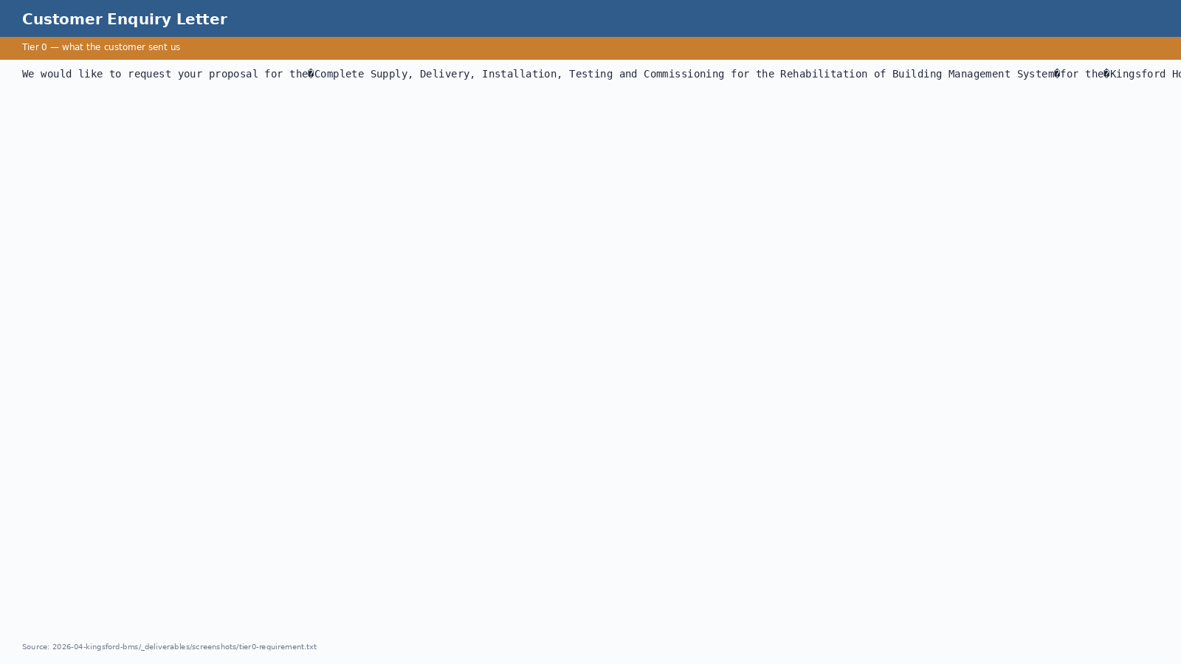
Tier 0 — Customer Enquiry Letter (Requirement.rtf)
One-paragraph scope statement. Note the word 'Rehabilitation' — the trigger for our triangulation rule on stage classification.

Slide 8
Tier 0 — BMS Points list (TUEC), Sheet BMS-01
A1-format Construction Bulletin from R.J. Calpo & Co. — General BMS specifications + I/O tabulation per system.

Slide 9
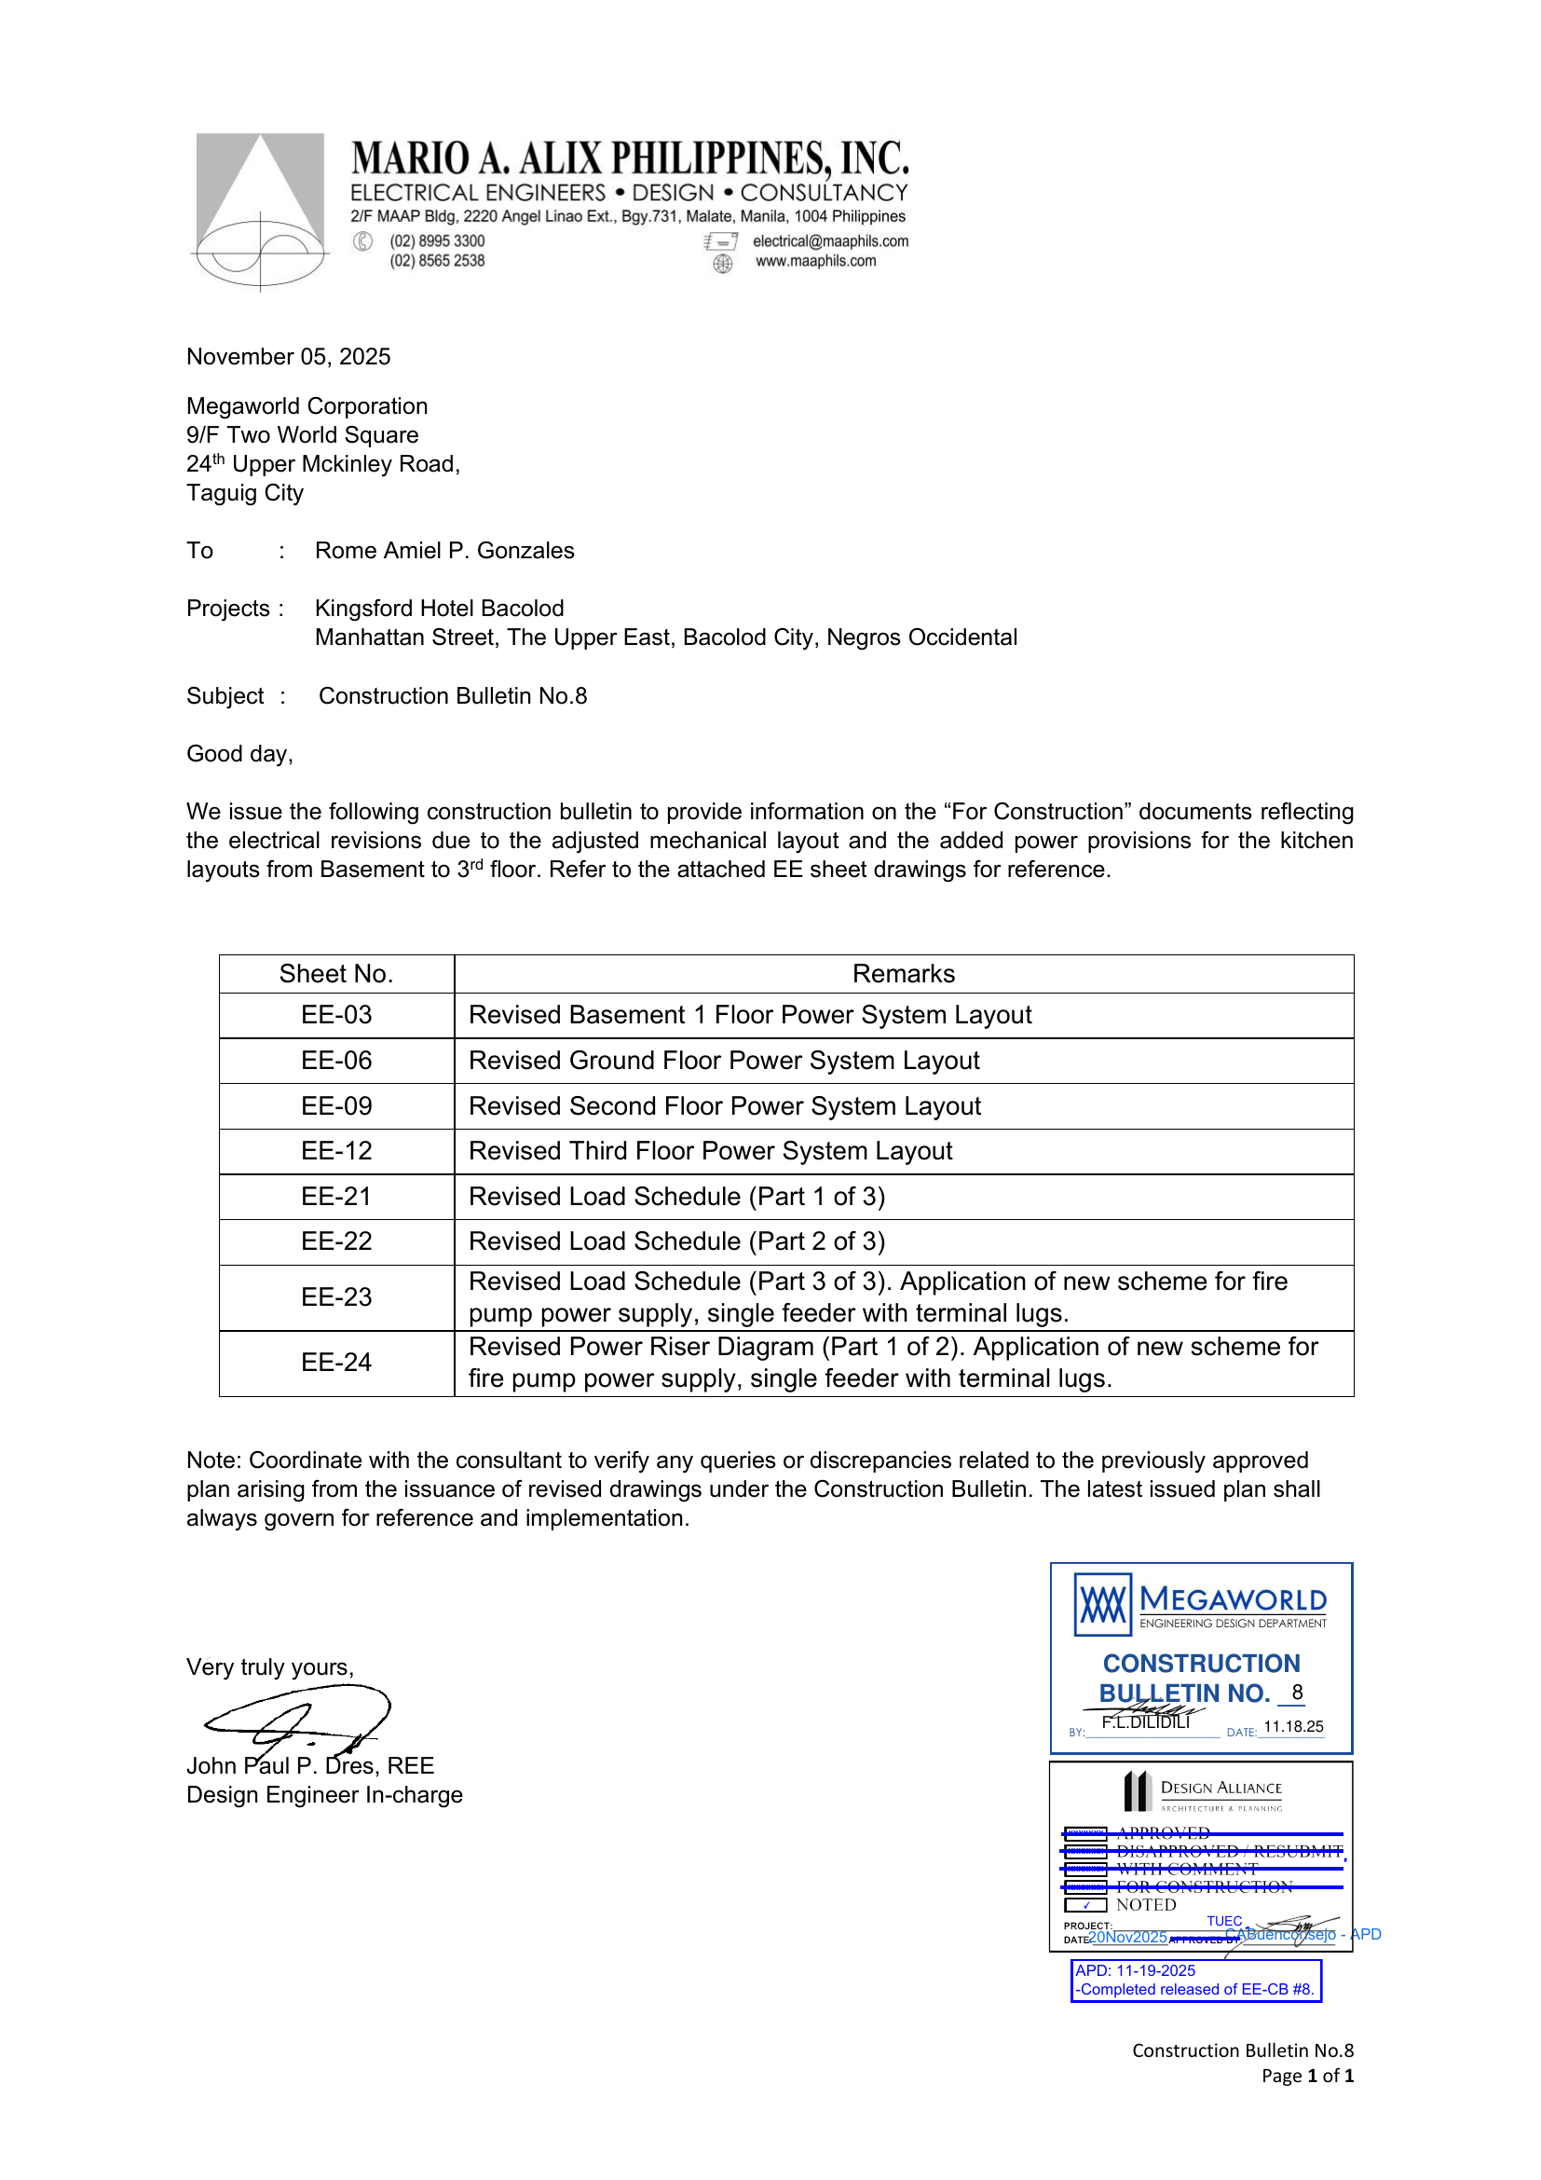
Tier 0 — EE Plan (TUEC), Cover Letter
Construction Bulletin No.8 cover from Mario A. Alix Phils. — adjusts mechanical layout and adds kitchen power provisions.

Slide 10
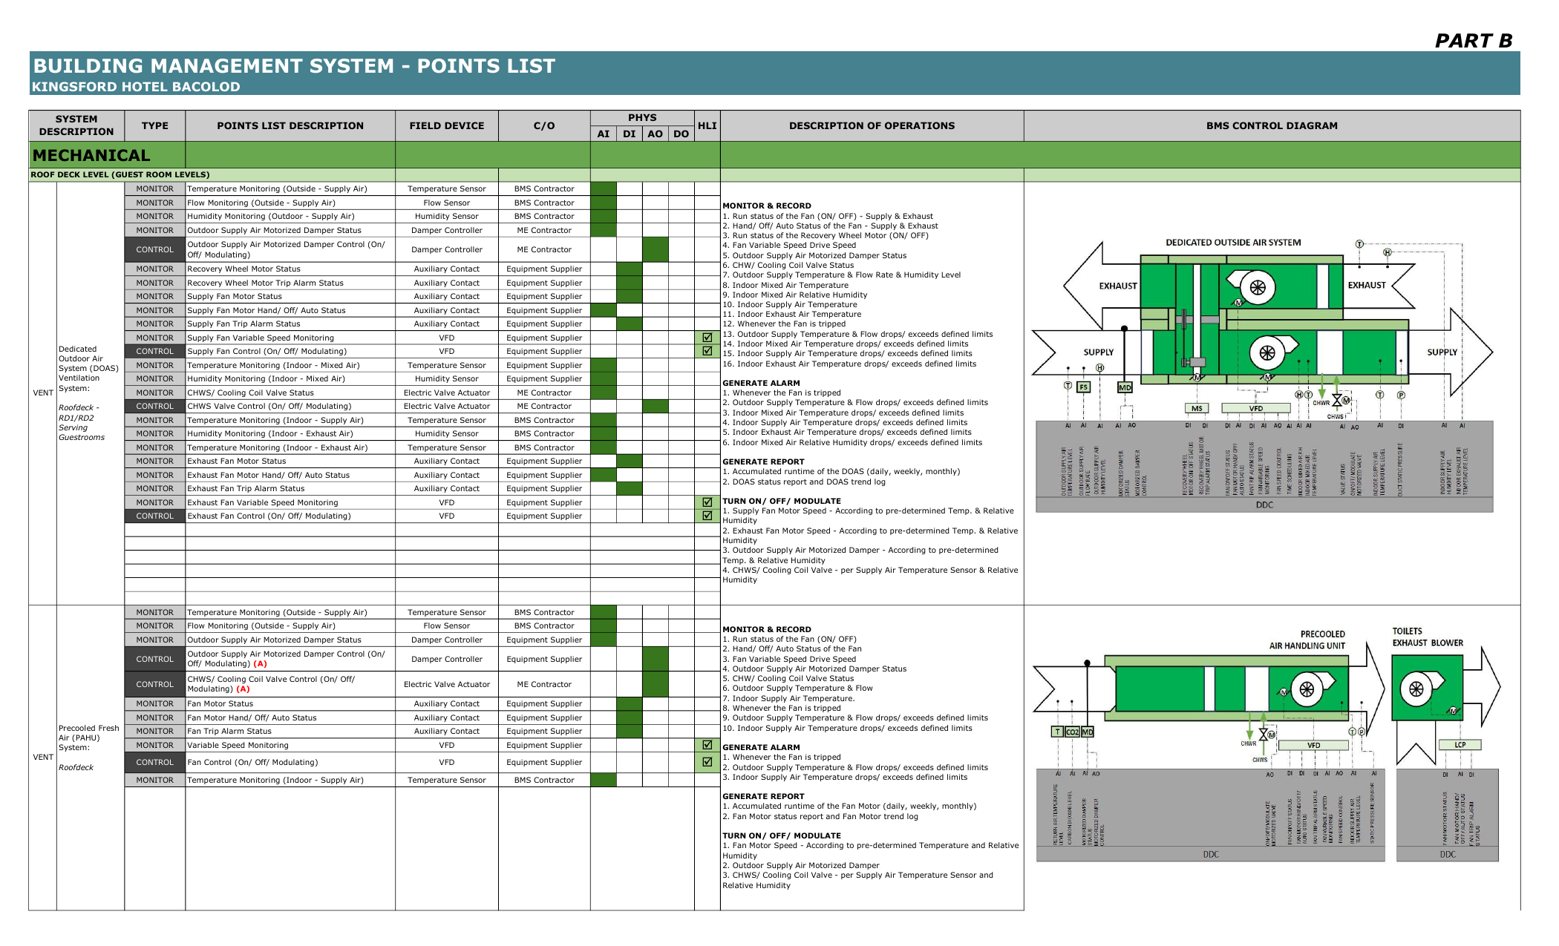
Tier 0 — MC Standards, Mechanical Points List
Megaworld's CONDOTELS BMS standard for mechanical systems — applies as baseline where the project-specific is silent.

Slide 11
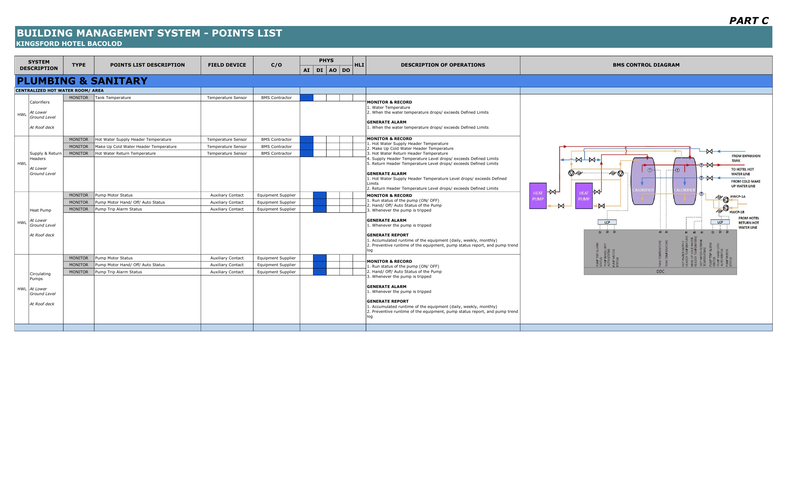
Tier 0 — MC Standards, Plumbing Points List
Megaworld's CONDOTELS BMS standard for plumbing — calorifiers, heat pumps, recirculating pumps.

Slide 12
End-to-End Flow
Each box is a sub-routine. ⛧ marks gates where the team validates before continuing.
Tier 0 — Customer Inputs
(scope letter, points list,
drawings, standards)
1. Intake
(Tier 1)
2. Classify
(Tier 1)
3. Doc Inventory ⛧
(Tier 1)
4. WBS
(Tier 2)
5a. Working Docs
(Tiers 1 → 5)
5b. Scope Modules
(Tier 4)
6. BOQ
(Tier 6)
7. Assumptions
(Tier 5)
8. RFI ⛧
(Tier 5)
9. RFQ Package
(Tier 7)
10. Proposal
(Tier 7)
Tier 8 — Final Rendered Deliverables (PDF + DOCX + Excel + PPTX)

Slide 13
Tier 1
The agent's first interpretation
Documents produced directly from customer inputs — what the agent understands the project to be

Slide 14
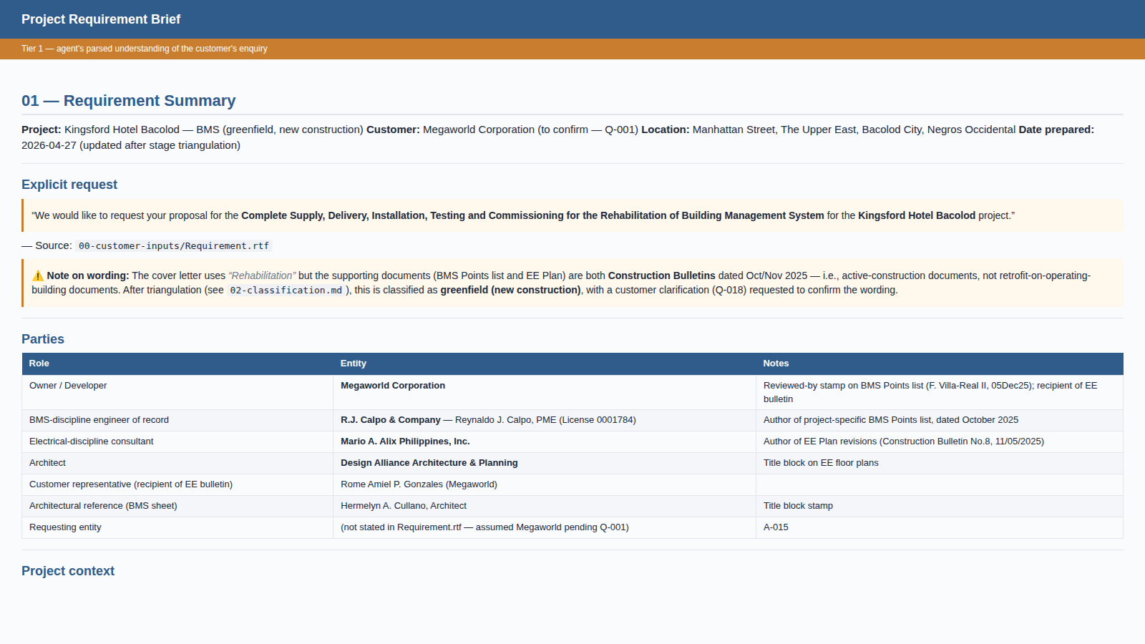
Tier 1 — Project Requirement Brief
Generated from Tier 0 customer enquiry letter + supporting docs. The agent's parsed understanding of who, what, and where.

Slide 15
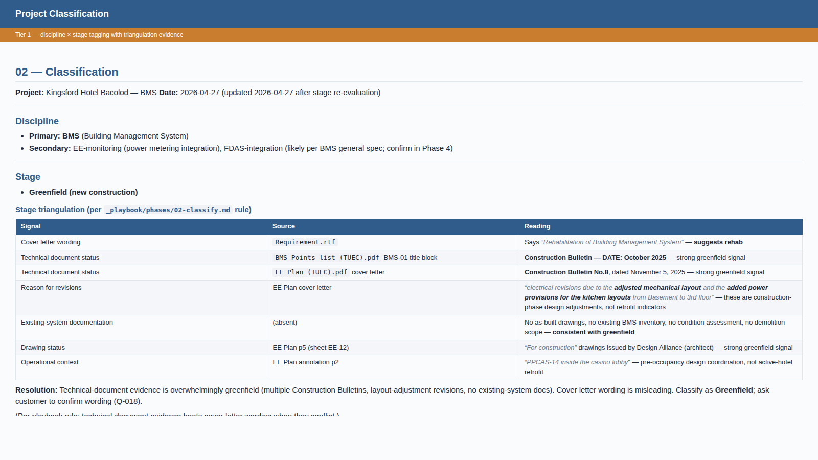
Tier 1 — Project Classification (with triangulation evidence)
Discipline × stage tagging. Note the triangulation table: technical-document evidence (Construction Bulletins) overrides the cover letter's 'rehabilitation' wording.

Slide 16
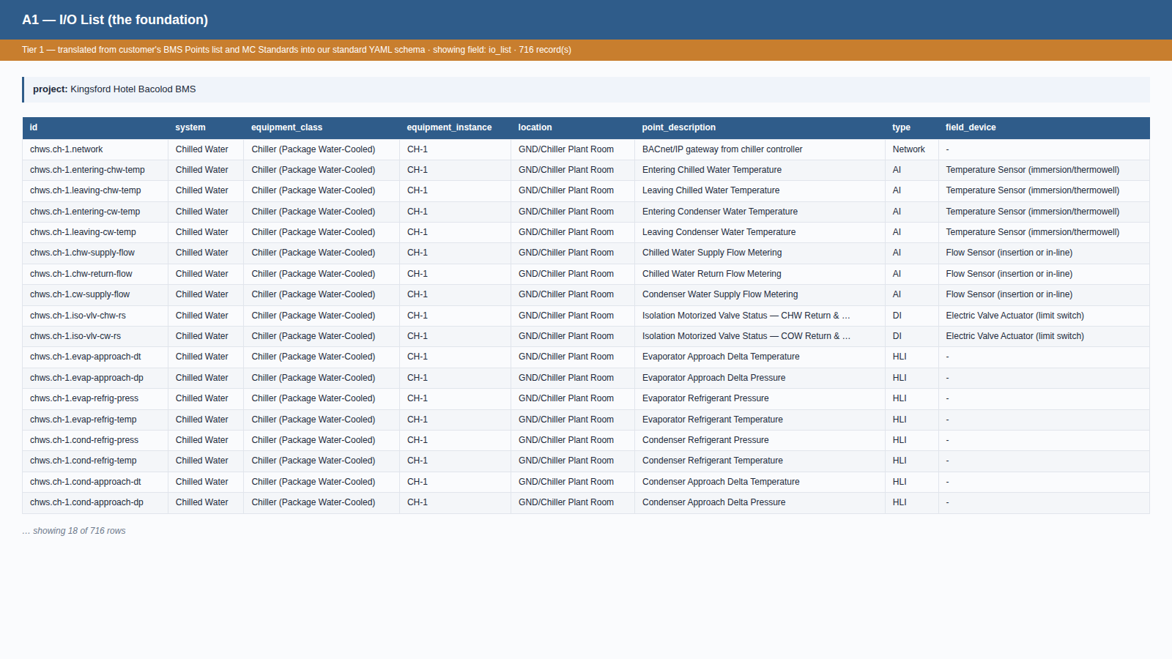
Tier 1 — A1 I/O List (the foundation)
Translated from BMS Points list + MC Standards into our standard YAML schema. 716 points; every row cites its source. Most downstream documents read from this.

Slide 17
Tier 2
The engineering basis begins
WBS, applicability matrix, and the first round of derived working documents

Slide 18
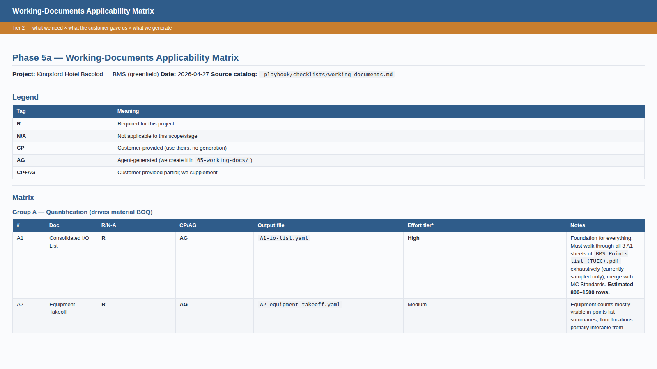
Tier 2 — Working Documents Applicability Matrix
The agent's check-and-translate-and-generate plan. R/N-A × CP/AG/CP+AG marking for all 17 working-doc types.

Slide 19
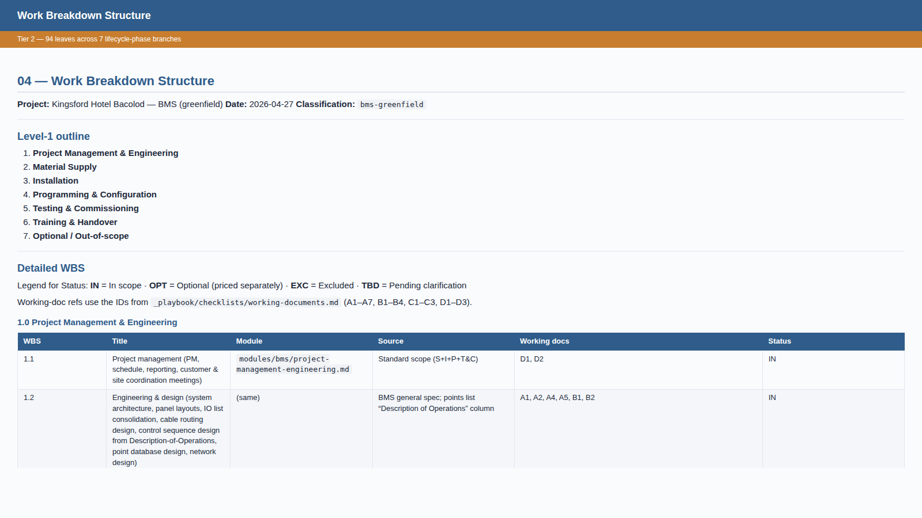
Tier 2 — Work Breakdown Structure
94 leaves across 7 lifecycle-phase branches (PM, Supply, Install, Programming, T&C, Training, Optional). Each leaf cites a module template.

Slide 20
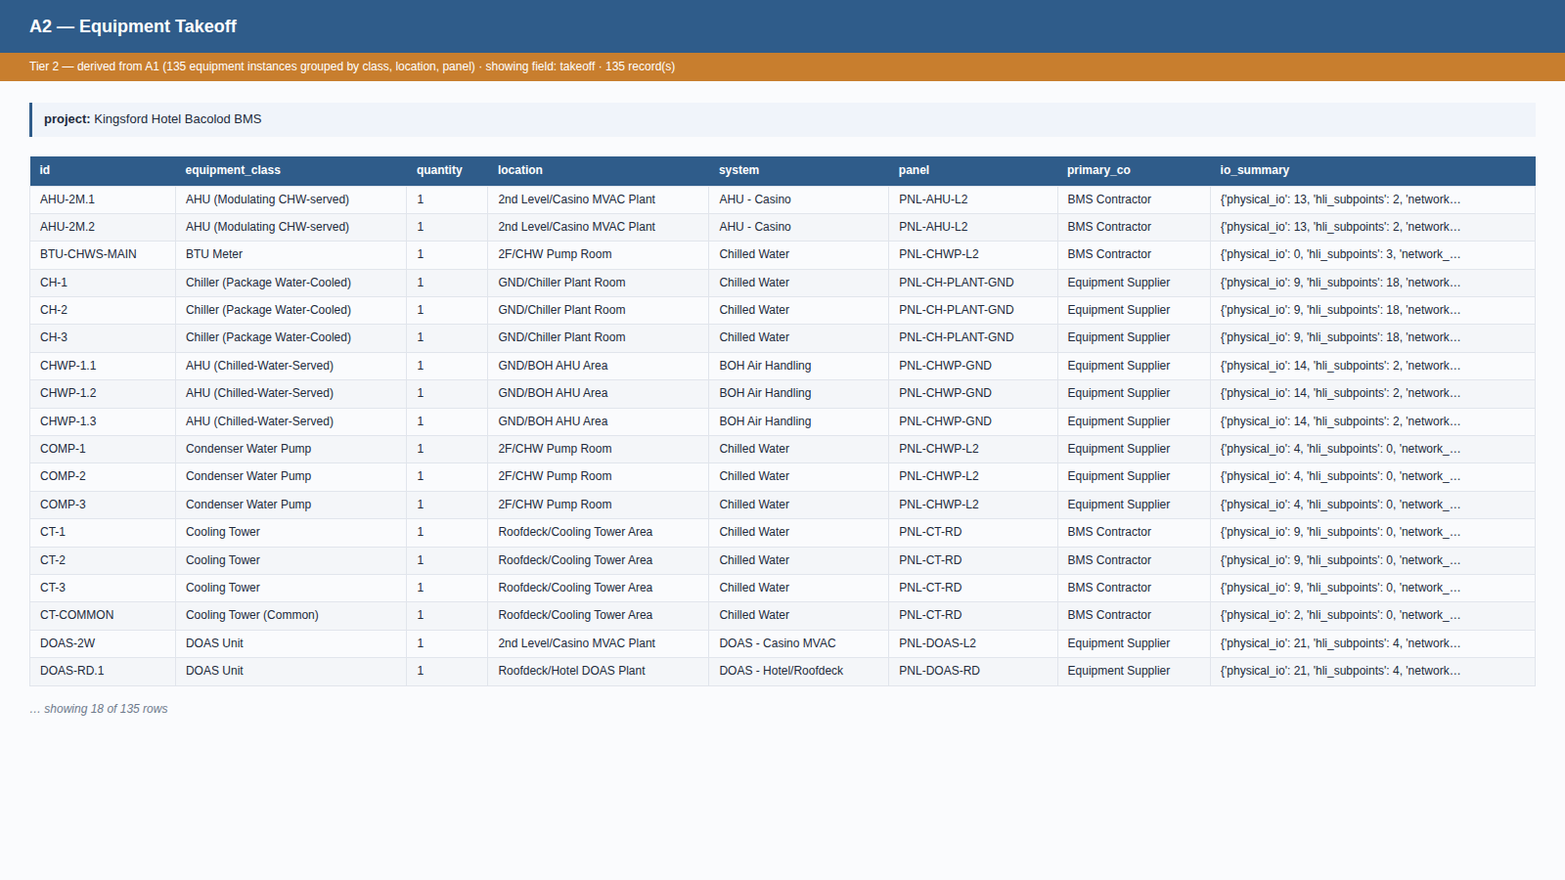
Tier 2 — A2 Equipment Takeoff
Auto-derived from A1: 135 equipment instances grouped by class, location, panel, and primary supplier.

Slide 21
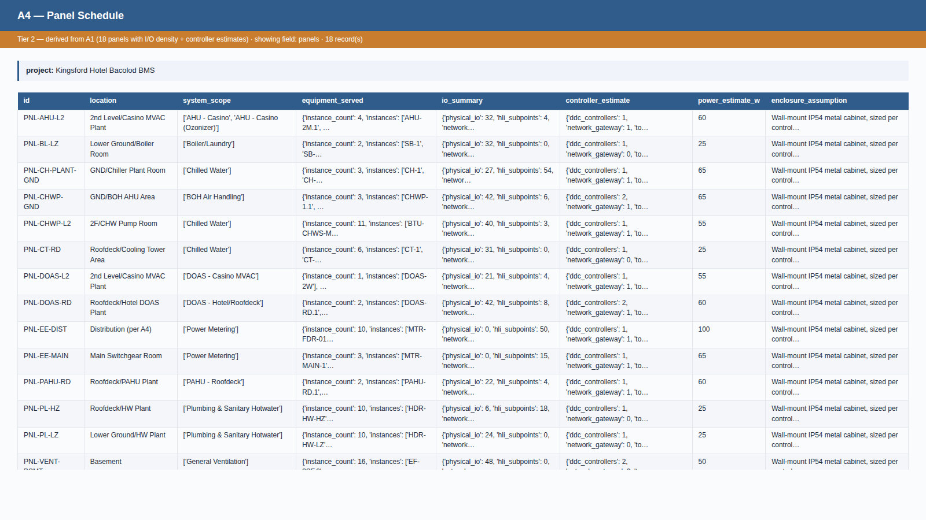
Tier 2 — A4 Panel Schedule
Auto-derived from A1: 18 BMS panels with I/O density, controller estimate, power consumption.

Slide 22
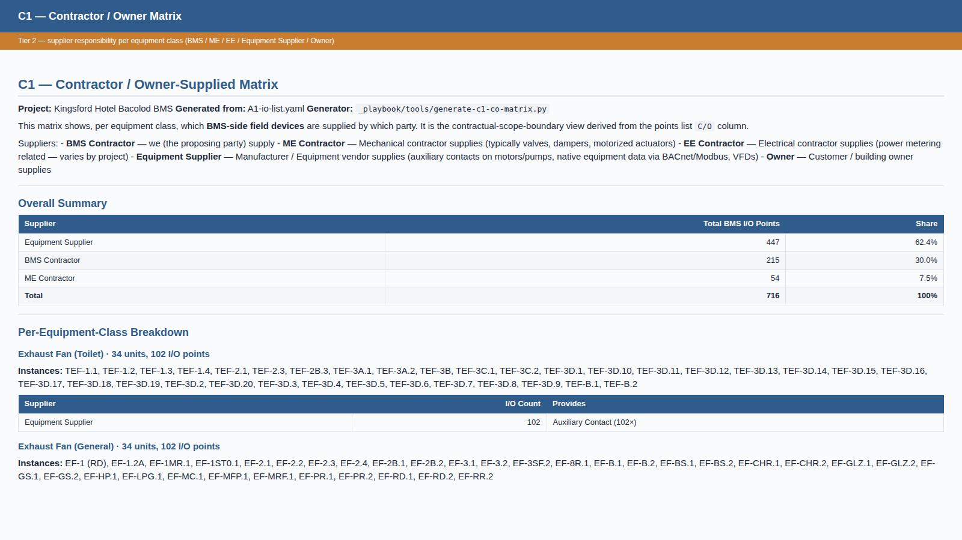
Tier 2 — C1 Contractor / Owner Matrix
Auto-derived from A1: per-equipment-class supplier responsibility — BMS / ME / EE / Equipment Supplier / Owner — with I/O counts.

Slide 23
Tier 3
Derived working documents
Cable schedule, network architecture, commissioning inventory — built on Tier 2

Slide 24
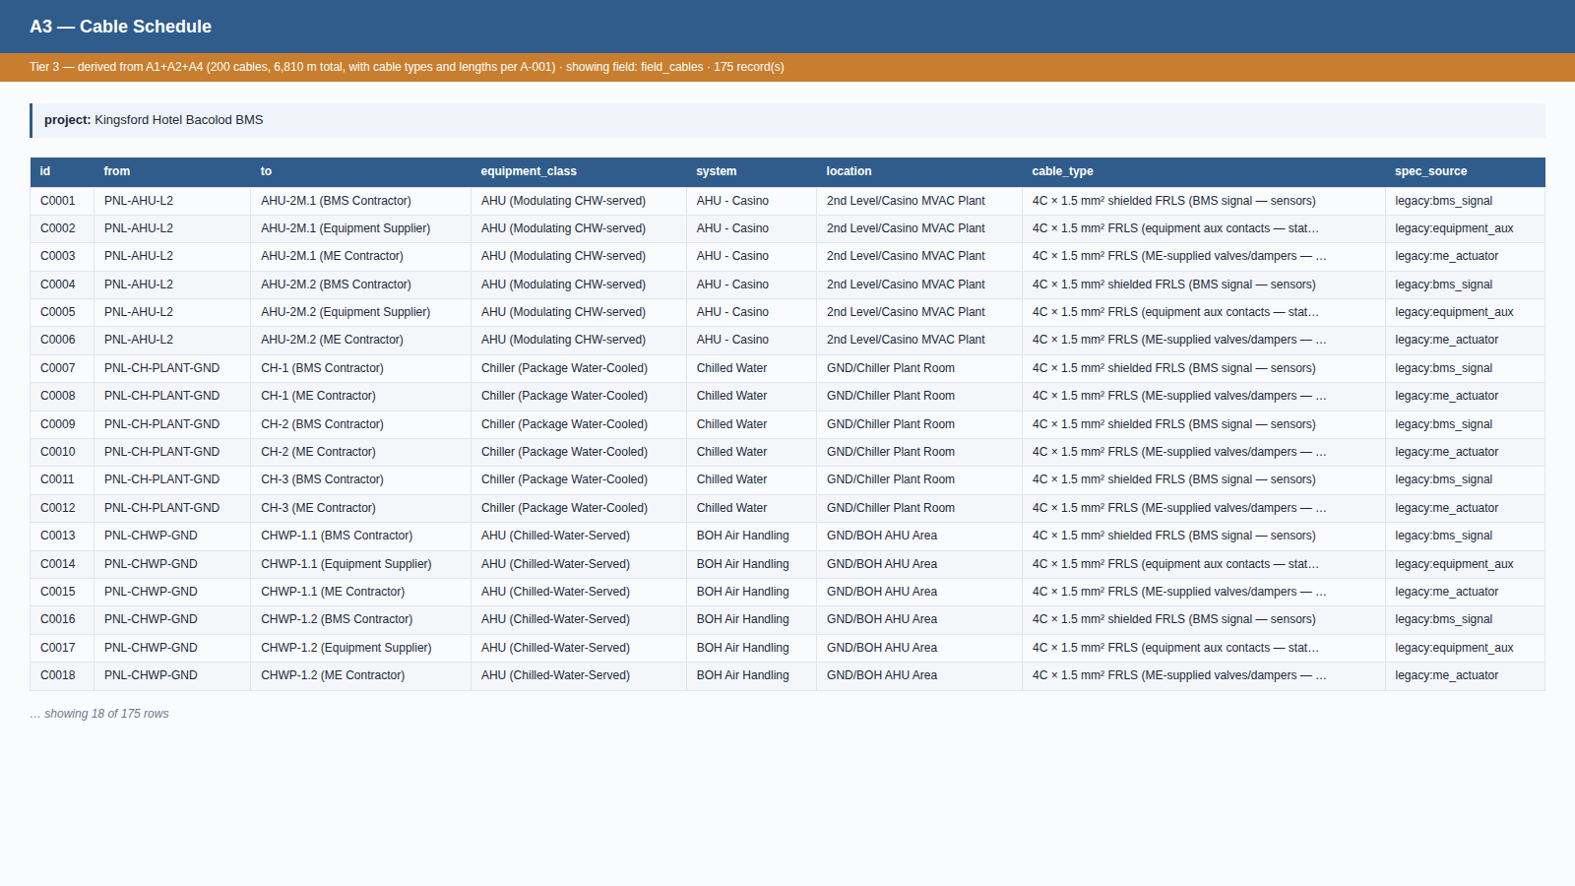
Tier 3 — A3 Cable Schedule
Auto-derived from A1+A2+A4 with cable-length assumption A-001. 200 cable runs; 6,810 m total.

Slide 25
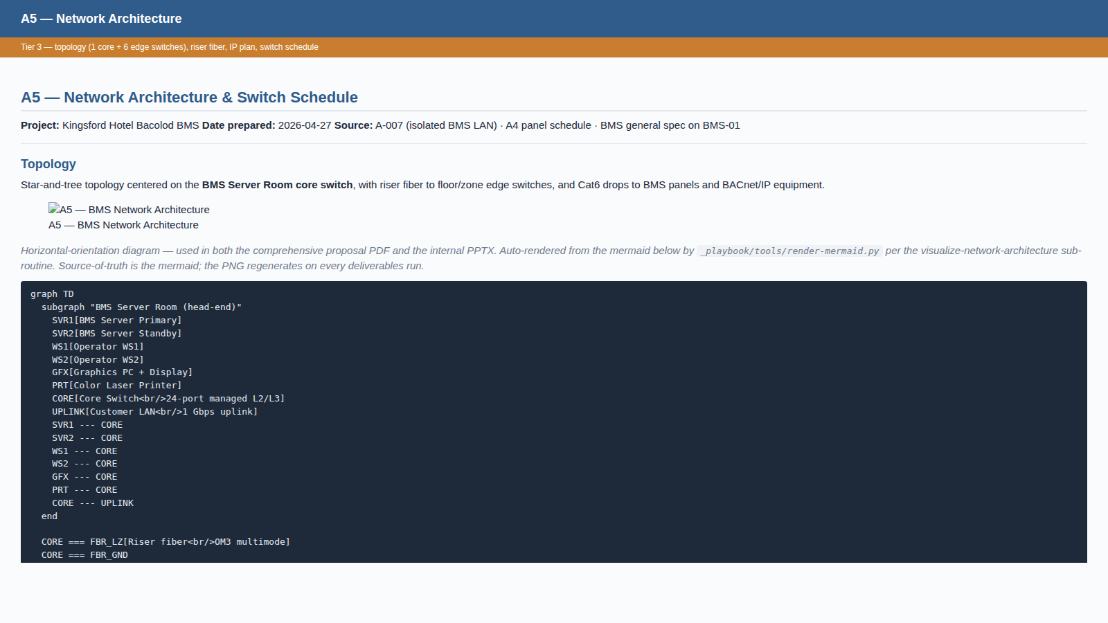
Tier 3 — A5 Network Architecture (formatted MD)
Hand-curated topology and switch schedule. 1 core + 6 edge switches, OM3 fiber backbone, flat /24 IP plan.

Slide 26
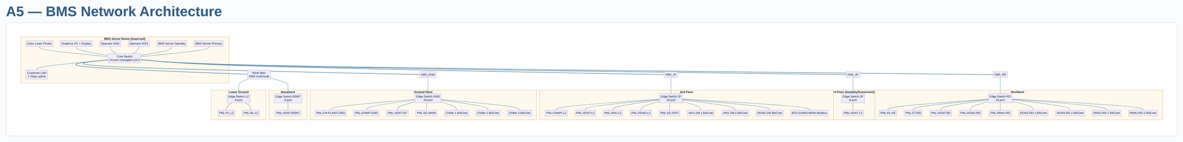
Tier 3 — A5 Network Architecture (visual diagram)
Auto-rendered from the A5 mermaid block. Star-and-tree centered on the core switch; riser fiber to per-floor edge switches; BACnet/IP equipment direct to the floor switch.

Slide 27
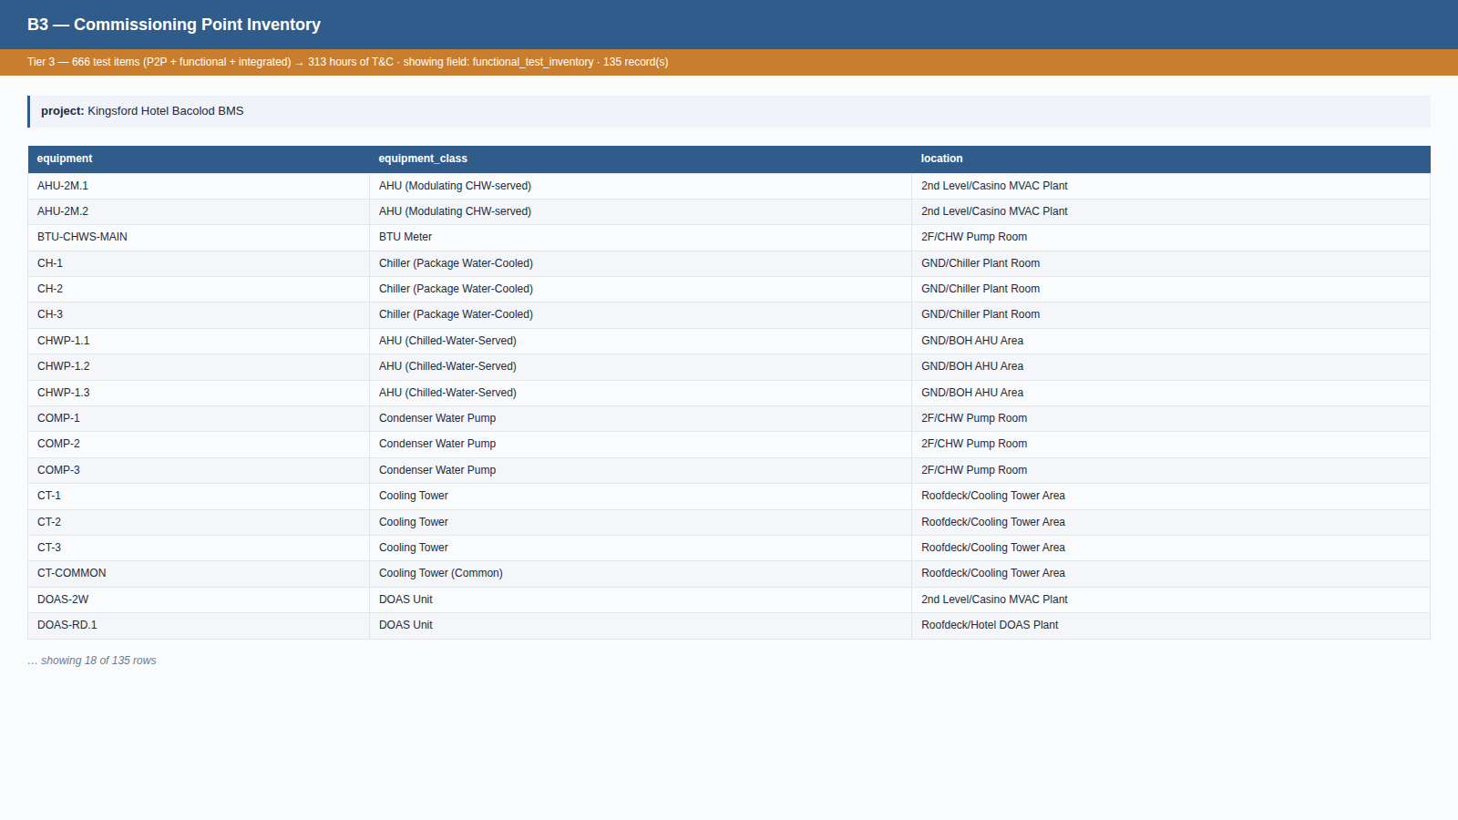
Tier 3 — B3 Commissioning Point Inventory
Auto-derived from A1+A2: every physical I/O for P2P, every equipment for functional tests, plus 8 cross-system integrated sequences. 313 hours of T&C.

Slide 28
Tier 4
Integrated outputs and scope modules
Manpower, schedule, risks, and the 11 scope-module instances

Slide 29
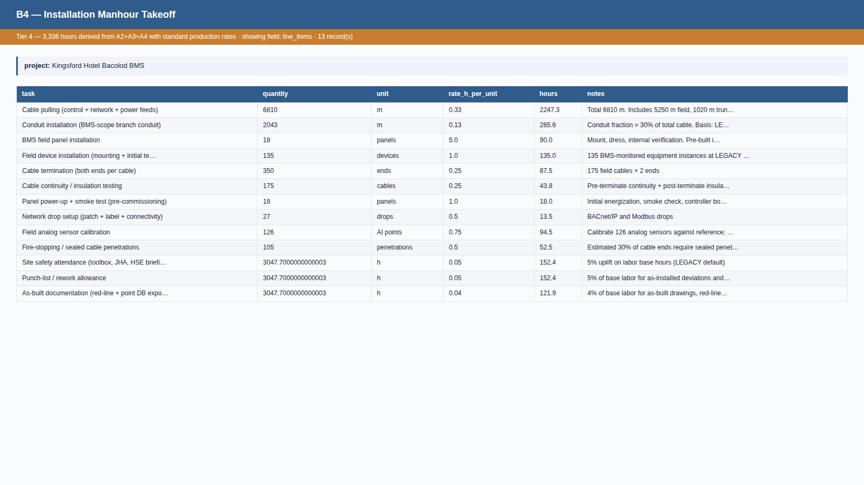
Tier 4 — B4 Installation Manhour Takeoff
Auto-derived from A2+A3+A4 using standard production rates. 3,336 hours installation labor; 417 person-days.

Slide 30
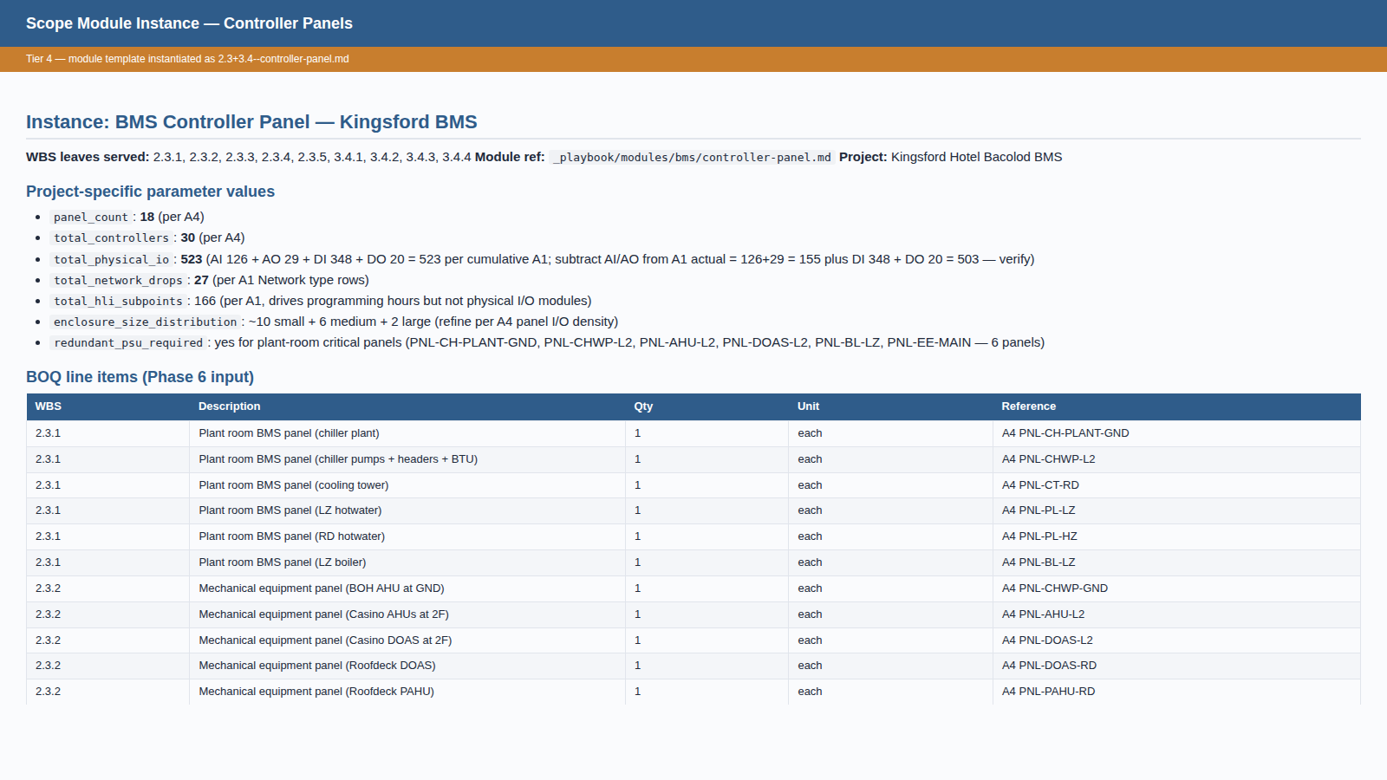
Tier 4 — Scope Module Instance (Controller Panels)
One of 11 scope modules instantiated for Kingsford. Module template + project-specific parameters → BOQ-ready line items.

Slide 31
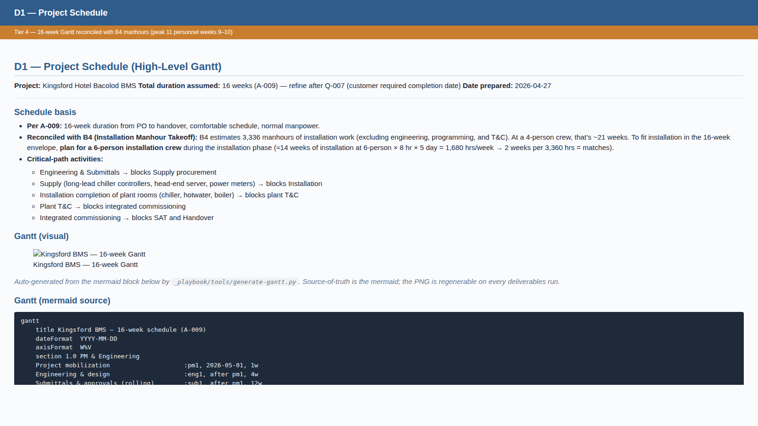
Tier 4 — D1 Project Schedule
Hand-curated 16-week schedule reconciled with B4 manhours. Reveals: 4-person crew can't fit; need 6-person.

Slide 32
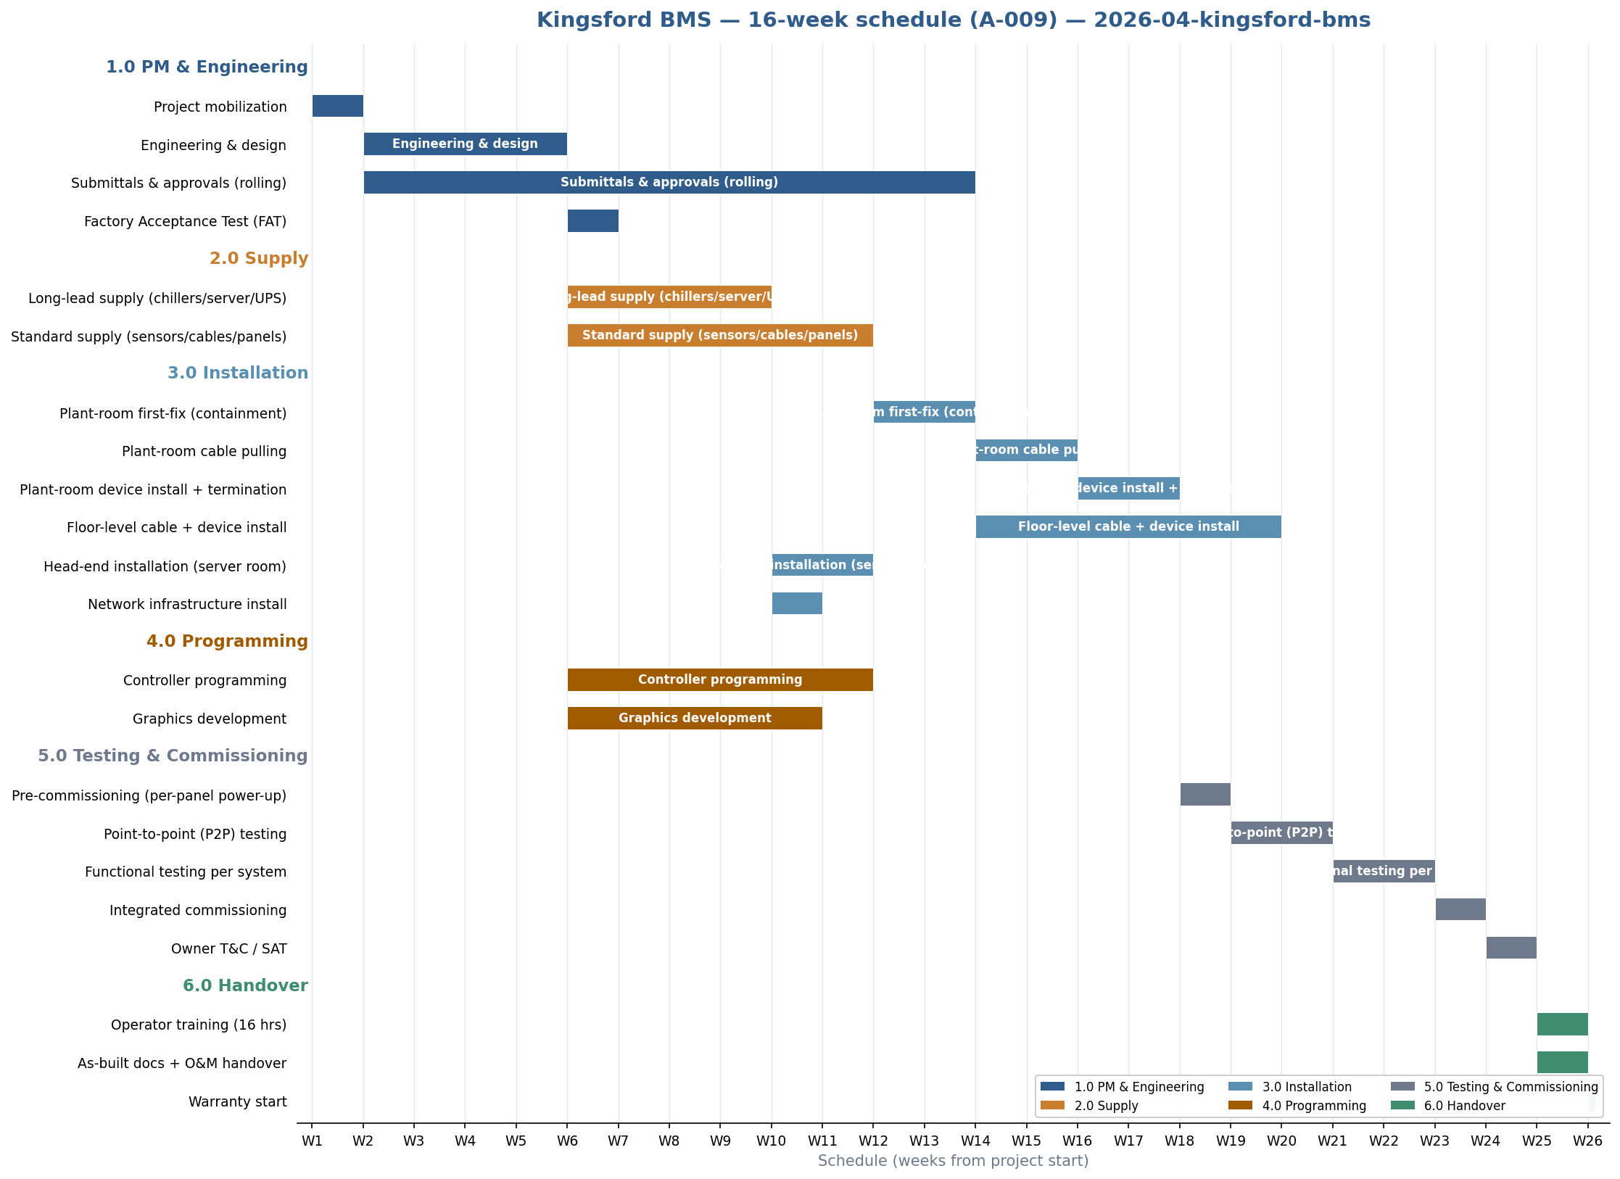
Tier 4 — D1 Project Schedule (visual Gantt)
Auto-generated from the D1 schedule. Sections colour-coded by lifecycle phase; milestones shown as diamonds.

Slide 33
Tier 6
Bill of Quantities — the costed output
86 line items aggregated from working docs + pricing rate library — PHP 21.98 M grand total

Slide 34
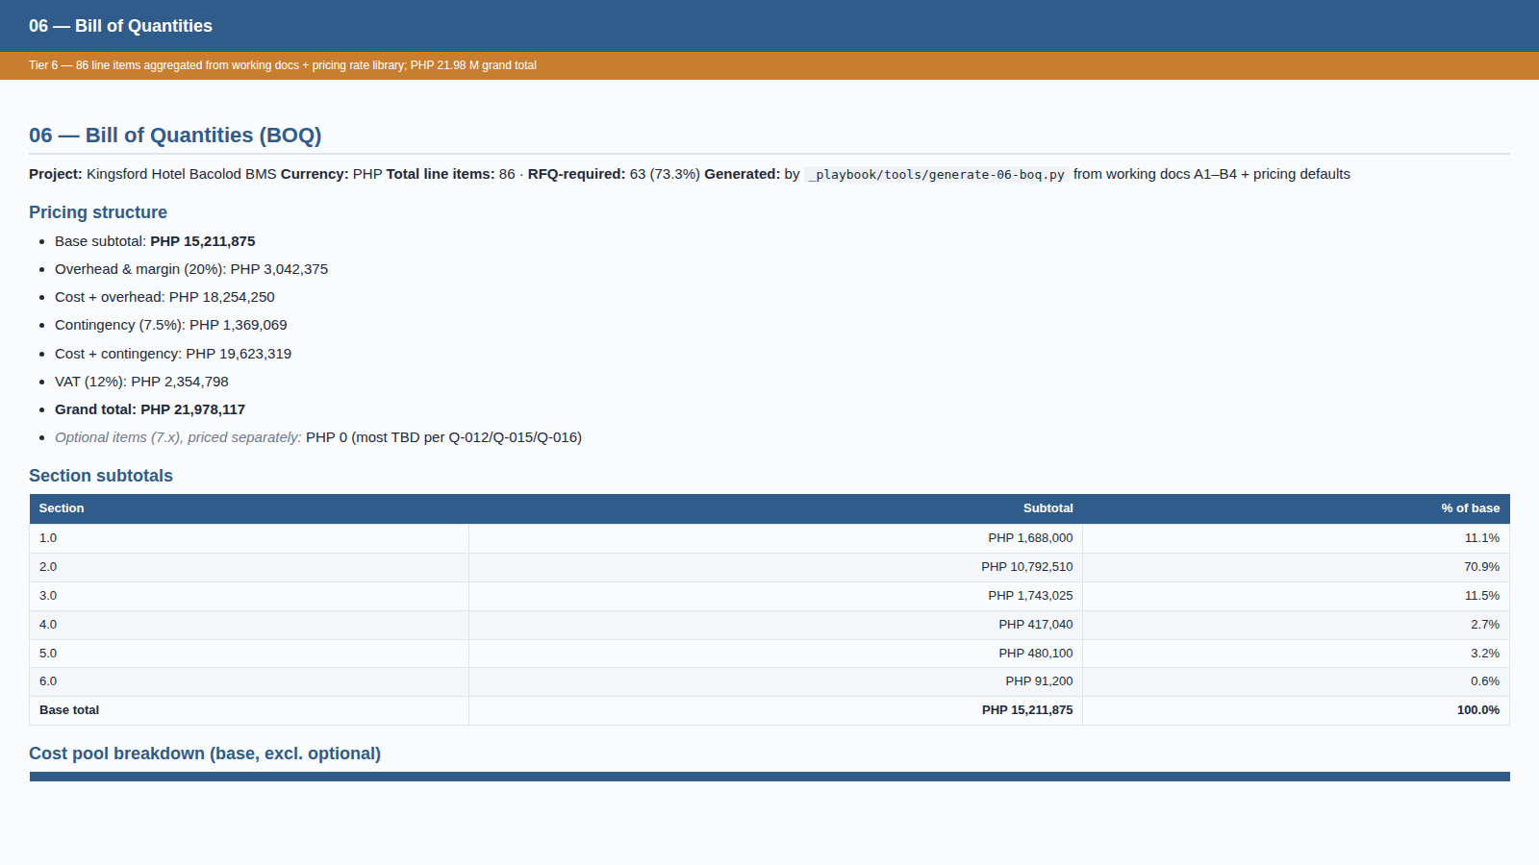
Tier 6 — Bill of Quantities
Mechanical aggregation: the BOQ generator reads working docs A1–B4 and applies the pricing rate library. Every line cites its source.

Slide 35
Tier 7
Customer-facing synthesis
The proposal narrative + supplier RFQ package

Slide 36
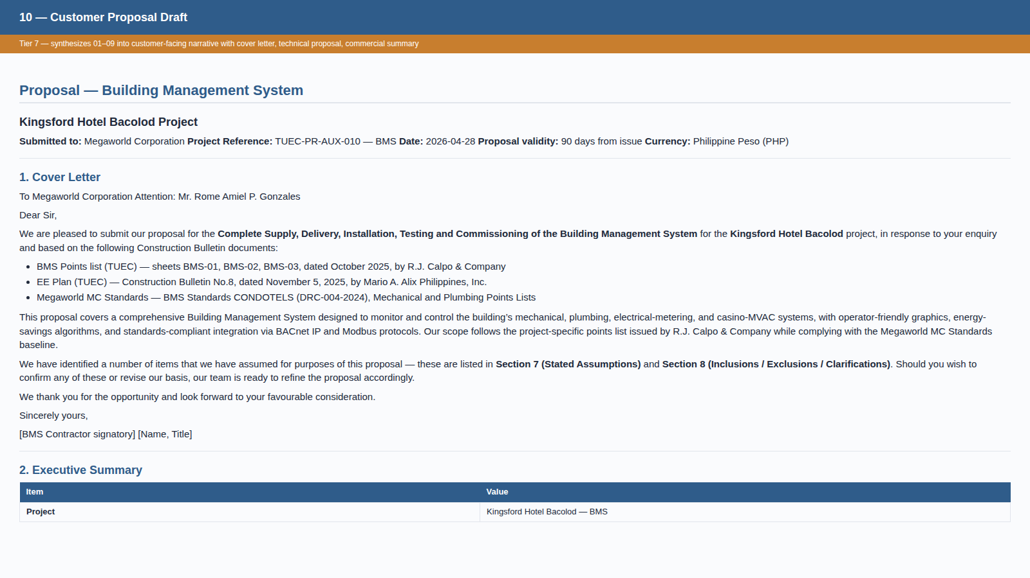
Tier 7 — Customer Proposal Draft
Synthesizes Tiers 1–6 into a customer-facing narrative: cover letter, executive summary, technical proposal, schedule, commercial summary, stated assumptions, inclusions/exclusions.

Slide 37
Tier 8
Final rendered deliverables
13 customer-ready files produced from a single command

Slide 38
Tier 8 — Final Deliverables Package
Mechanical helpers render Tier 7 markdown/YAML into PDF / DOCX / Excel / PPTX
File | Format | Size | Pages / Sheets / Slides
01-Initial-Overview | PDF | 80 KB | 7 pages
02-Proposal-Draft | PDF | 239 KB | 30 pages
03-BOQ-Bill-of-Quantities | Excel | 29 KB | 11 sheets
04-A1-IO-List | Excel | 51 KB | 2 sheets
05-A2-Equipment-Takeoff | Excel | 18 KB | 2 sheets
06-A3-Cable-Schedule | Excel | 20 KB | 4 sheets
07-A4-Panel-Schedule | Excel | 10 KB | 3 sheets
08-Open-Items-RFI | Word | 15 KB | —
09-Stated-Assumptions | Word | 16 KB | —
10-Proposal-Comprehensive | PDF + DOCX | 1.5 MB + 50 KB | 92 pages
11-Customer-Proposal-Presentation | PowerPoint | 74 KB | 31 slides
12-Internal-Methodology-Presentation | PowerPoint | 70 KB | this deck

Slide 39
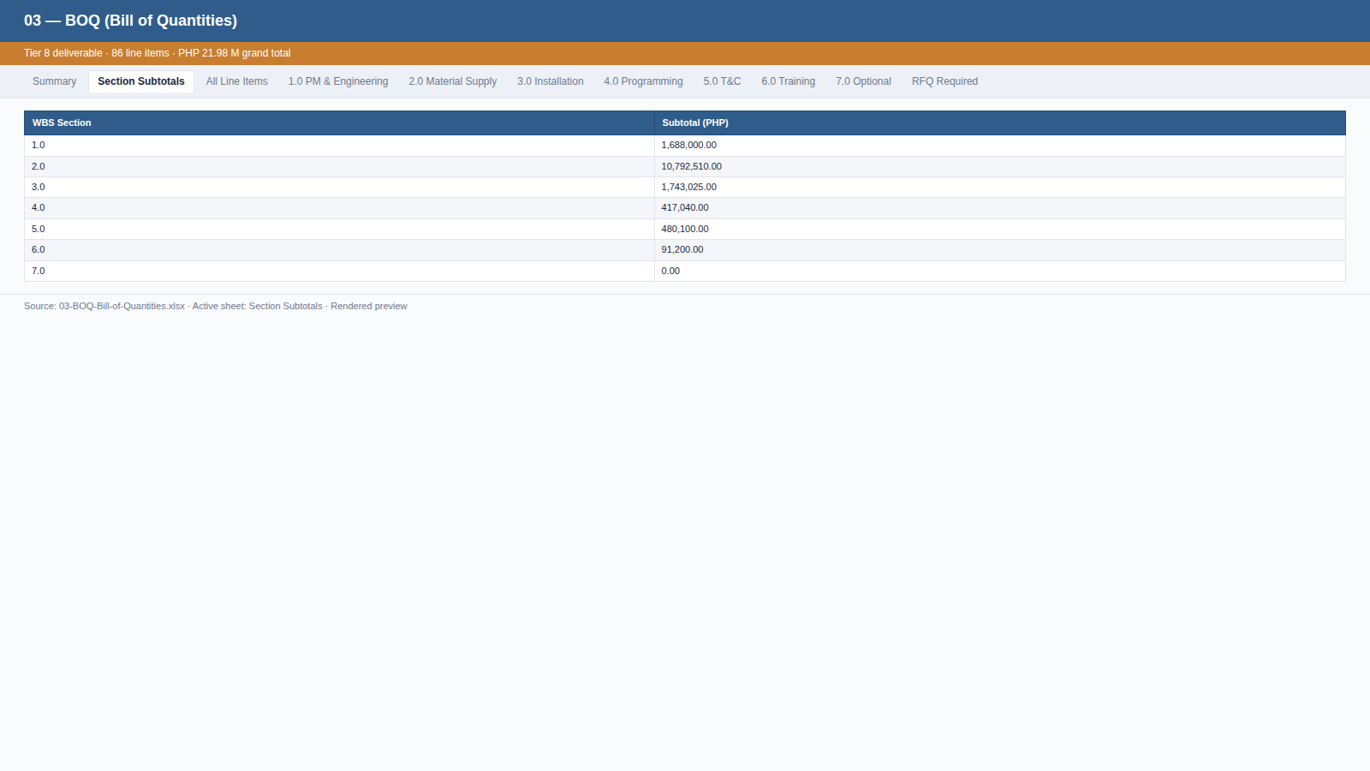
Tier 8 — BOQ (Bill of Quantities), Section Subtotals
The Excel file the team opens. Multi-sheet workbook — Summary, Section Subtotals, All Line Items, per-WBS sheets, RFQ Required filter. PHP 21.98 M grand total.

Slide 40
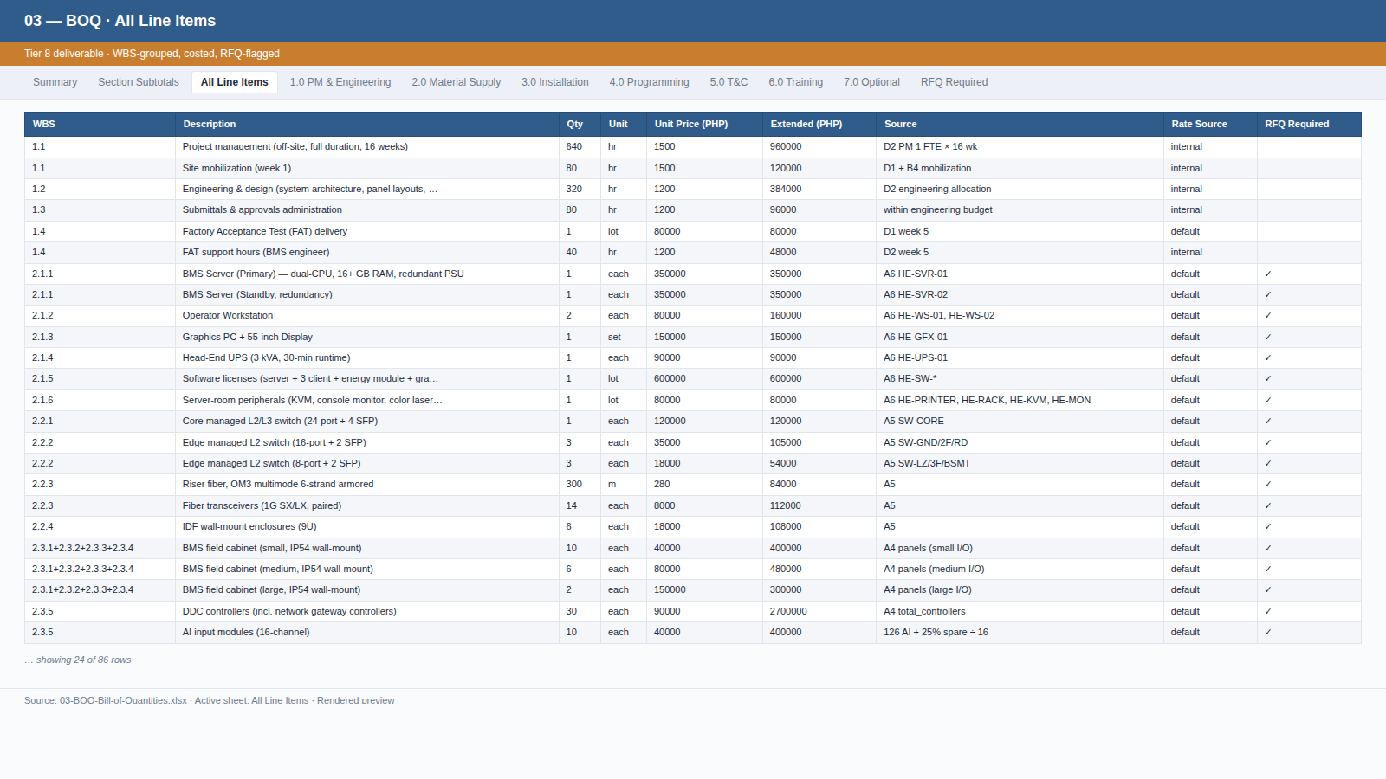
Tier 8 — BOQ · All Line Items
86 costed line items, WBS-grouped, RFQ-flagged. Every quantity traces to a working doc; every rate to the pricing rate library.

Slide 41
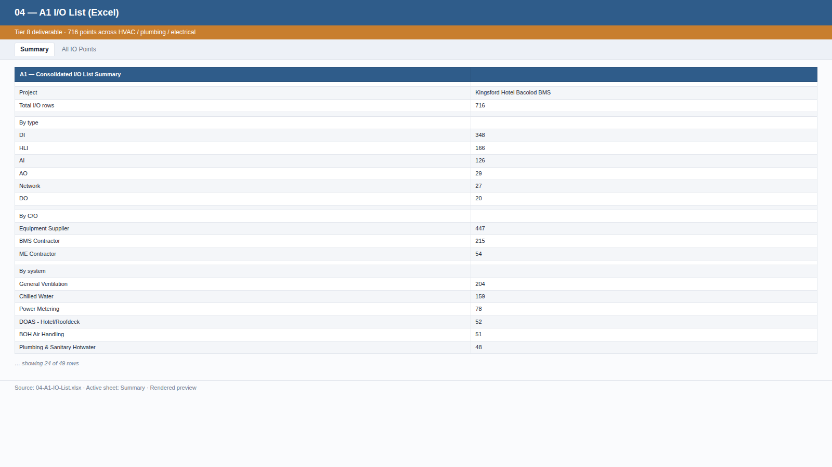
Tier 8 — A1 I/O List (Excel)
716 points across HVAC / plumbing / electrical, with system / equipment / location / panel / point description / type / source.

Slide 42
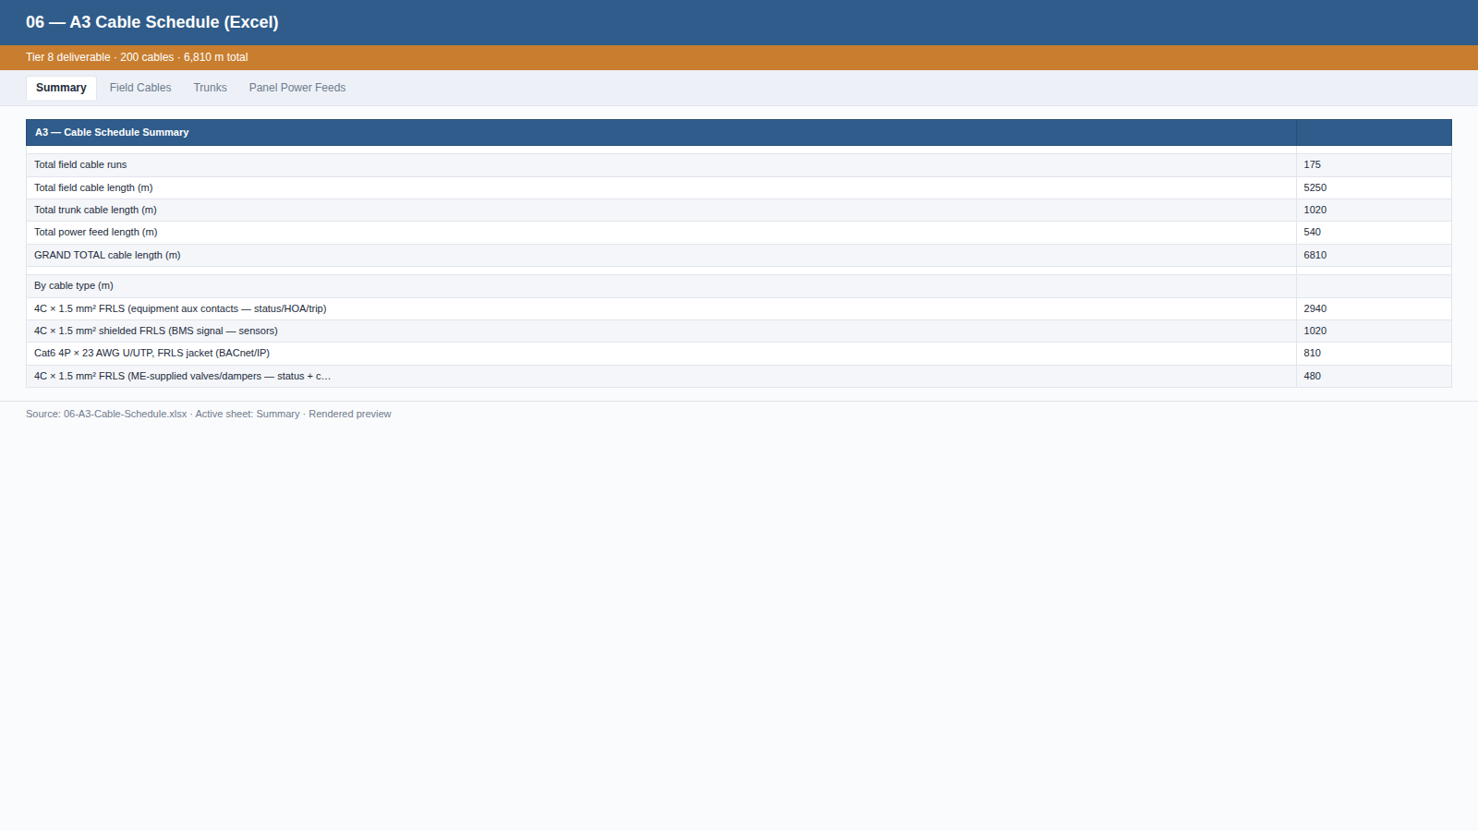
Tier 8 — A3 Cable Schedule (Excel)
200 cables, 6,810 m total. From / To / cable type / length / source — sortable, filterable by panel / floor.

Slide 43
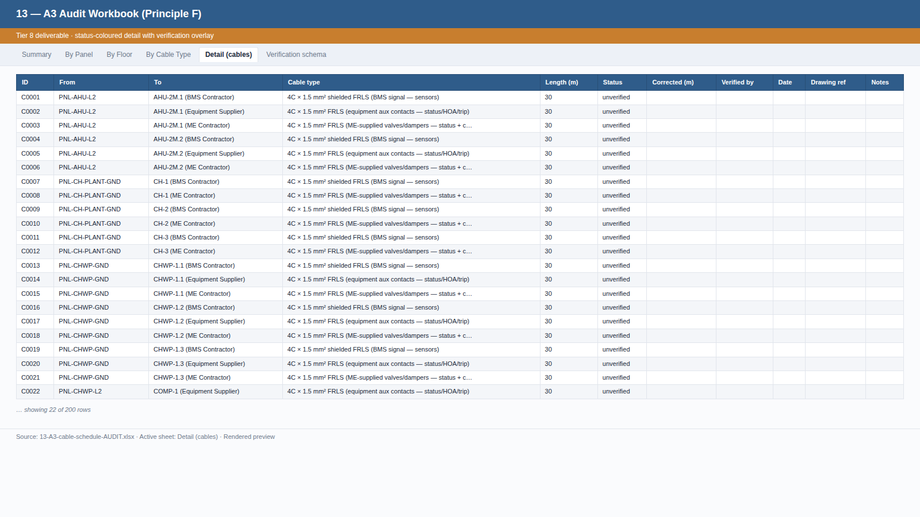
Tier 8 — A3 Audit Workbook (Principle F)
Per-cable Detail with status-coloured cells (green/red/yellow/grey) — auto-filter so the team can isolate unverified rows for site walkthroughs.

Slide 44
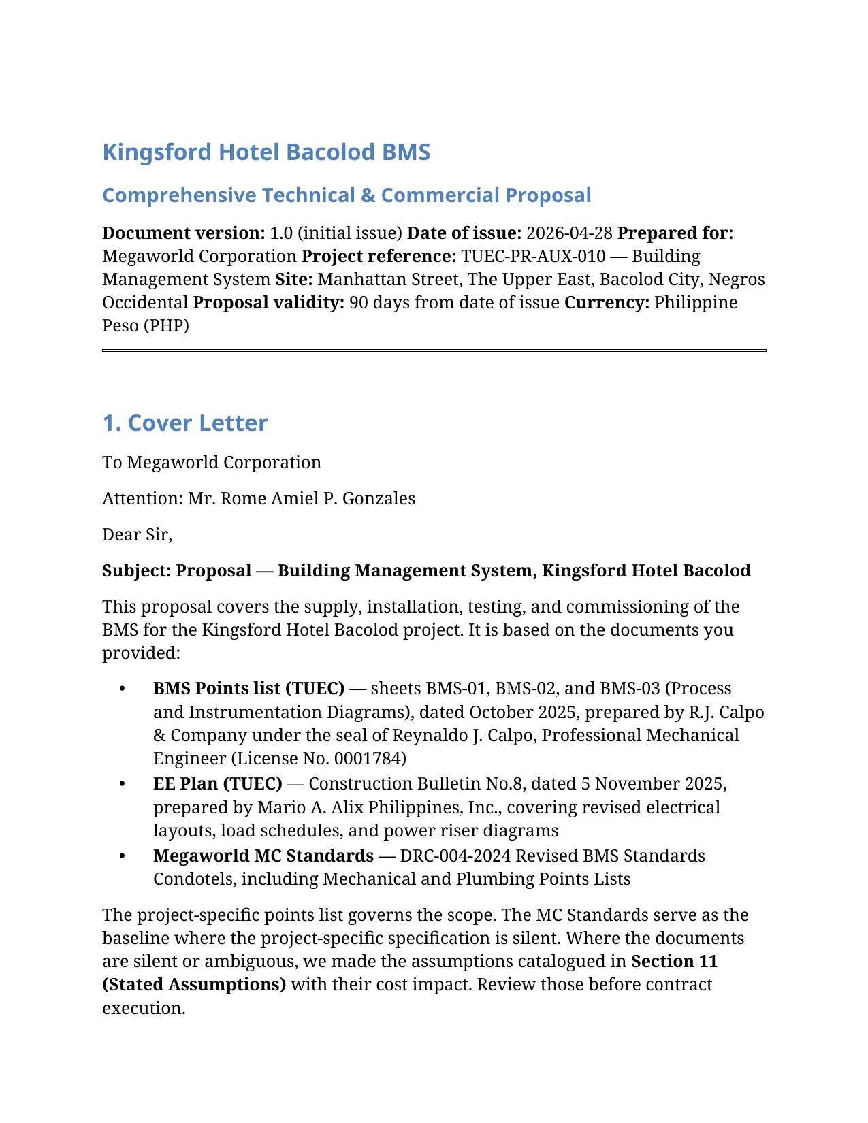
Tier 8 — Comprehensive Proposal (PDF cover page)
The customer-facing PDF. ~92 pages: cover letter, executive summary, technical proposal, schedule, commercial summary, stated assumptions, inclusions/exclusions.

Slide 45
Principles
Why the framework holds together
Five design principles that govern every project

Slide 46
Design Principles A–F
These principles govern when to extend the framework and what to keep adaptive
 | Principle | Why it matters
A | Mechanical helpers operate only on standardized agent-prepared data | Customer document interpretation stays adaptive, in agent instructions
B | Engineering judgment lives in agent instructions | Agent CAN write project-specific helpers when needed; permanent tools are mechanical
C | The applicability check is foundational | Phase 5a always begins with 'what we need vs. what's given'
D | Determinism through standard formats — and translation when needed | Customer-provided docs are translated to standard format BEFORE downstream work
E | Document tier classification (the dependency DAG) | Strict tier ordering; no circular references; build order is known
F | Transparency and auditability — never hide weak spots | Auto-generated quantities the team must verify get a verification overlay + sibling audit workbook

Slide 47
Determinism through standard formats
Standard formats are the contract that lets mechanical helpers run reliably
Standard formats (the contract)
Every working-doc type has ONE canonical format:
• I/O list — standard YAML schema (id, system, equipment, location, point description, type, field device, C/O, source, ...)
• BOQ — standard YAML schema (line items with WBS, qty, unit, rate, source, RFQ flag)
• Cable, panel, equipment takeoff — each has a single canonical format
• Pricing rate library + equipment-class defaults — standard YAML, peer-reviewable
Translation at the entry boundary
When the customer supplies a document that covers a working-doc type:
1. The agent transcribes it into our standard format BEFORE proceeding.
2. Each translated row cites the customer's source file for traceability.
3. Schema mismatches surface as assumptions and clarifications.
4. Downstream work always operates on the standardized representation, never on the customer's native format.
Result: regardless of customer format variation, downstream pipeline stays deterministic.

Slide 48
Where mechanical automation ends and judgment begins
We're conservative about what we automate
Mechanical (Python helpers)
Pure data aggregators on standardized YAML — no customer-document interpretation:
• BOQ aggregator
• RFQ packager
• Excel exporters
• PDF / DOCX rendering
• Presentation builders
Why safe:
– No customer-document interpretation
– Input/output formats are fixed
– Every quantity is sourced from agent-prepared data
Agent-driven (sub-routines / instructions)
Adaptive instructions in the playbook — sub-routines the agent follows:
• Customer document extraction protocol
• Project classification (triangulation)
• Required-doc checklist comparison
• WBS scope decomposition
• Working-document applicability matrix
• Working-document content (e.g., interpreting a points list into an I/O list)
• Module instance parameter selection
• Assumption rationale and impact assessment
• Customer clarification framing
When format/scope is genuinely unique, the agent writes a project-specific helper script.

Slide 49
Principle F — Transparency & auditability layer
Some auto-generated quantities are inherently soft. We don't pretend; we make them visible and editable.
The honest framing
The named weakest spot: cable lengths.
Today the agent uses assumption A-001 — 30 m average panel-to-device run, 80 m trunk per floor — because we don't always have scaled drawings or a site walkthrough yet.
Field-verified lengths typically vary ±20% per cable. If we hide that, the BOQ looks more confident than it is.
The fix is a transparency layer that makes weak spots obvious and editable — not buried in a YAML footnote.
The mechanism (Principle F)
How it works:
1. Every team-verifiable working doc (A1, A2, A3, A4, A6, B4, D1) supports a verification: overlay block per row — status / corrected_<field> / verified_by / drawing_ref / notes.
2. Mechanical helpers respect the corrected value when present — corrections flow into B4 manhours, BOQ, and final deliverables automatically.
3. A sibling Excel audit workbook is generated alongside each YAML — that's the team's review surface.
4. Audit workbook is regenerable; canonical YAML is the single source of truth.

Slide 50
The audit workbook — what the team actually opens
XLSX, multi-sheet, filterable. Built for how the proposal team works in Excel daily.
What's in the workbook
Each audit workbook contains:
• Summary — totals, status counts (colour-coded), known weak points, correction workflow
• Per-axis rollups — e.g., A3 cable schedule has By Panel / By Floor / By Cable Type
• Detail — every row with auto-filter + frozen header; status cells colour-coded (green=verified, red=needs correction, yellow=uncertain, grey=unverified)
• Verification schema — copy-pasteable YAML template + priority-ordered verification methods
How the team uses it
Workflow in practice:
• At desk: open A3-cable-schedule-AUDIT.xlsx, filter Detail by panel, cross-check totals against architectural drawings.
• On site: print or open on tablet, walk the building, mark up.
• Back at desk: edit A3-cable-schedule.yaml — add a verification: block with corrected_length_m, status, drawing_ref.
• Re-run the deliverables generator — corrections propagate.

Slide 51
Where this is going — the proposal cockpit (v1+)
v0 surfaces ask the user to think like the agent. The cockpit inverts that.
Where we are
Today (v0):
• Customer drops files in a folder
• Agent runs in a terminal
• Outputs land as XLSX / PDF / DOCX
• Verification = open Excel + edit YAML
Honest, but technical. The user has to think in our shapes.
Where we're going
Tomorrow (v1+ journey-style UX):
1. Drop-zone intake — drag-and-drop with auto-classified document tiles.
2. One 'Generate proposal' button — live phase-by-phase progress.
3. Tier walk — visual timeline Tier 0 → Tier 8, click any node to inspect lineage.
4. Audit cockpit — split-pane: drawing on left ~70%, filterable row list on right ~30%; click a row, drawing pans to the grid reference; inline-edit writes back to YAML.
5. Regen loop — one button refreshes downstream artifacts; diffs are visible per phase.

Slide 52
Quality and Trust
Why this approach delivers a defensible, auditable proposal
• ✓ Every quantity is traceable — each BOQ line cites its working doc; each working doc cites the customer's source document
• ✓ Assumptions are explicit — 19 stated assumptions in the proposal, each with cost-impact-if-wrong
• ✓ The basis is reproducible — re-run the aggregators and the same input produces the same output
• ✓ No hidden magic in labor / rates — pricing defaults are a peer-reviewable rate library
• ✓ Customer questions have documented answers — each clarification has a default assumed and a rationale
• ✓ Audit trail — every change committed with a 'why' message
• ✓ Deliverables are internally consistent — the BOQ in the PDF equals the BOQ in the Excel equals the BOQ in the proposal narrative

Slide 53
Time Savings: before vs. after
What used to take 2–3 weeks now takes 5–7 working days
Phase | Before (hand-rolled) | After (this framework)
Phases 1–4: Intake → WBS | 2–3 days, often inconsistent | 1 day with structured walkthrough
Phase 5a: Working docs | 5–7 days hand-typing | 2–3 days (about half are auto-aggregated)
Phase 5b: Module instantiation | Skipped or hand-built | 0.5 day (templates)
Phase 6: BOQ | 2–3 days hand-Excel | Hours (one command)
Phases 7–8: Assumptions + RFI | Often missed, ad-hoc | Hours (auto-organized)
Phase 9: RFQ to suppliers | Manual emails per category | Hours (12 docs auto-categorized)
Phase 10: Proposal narrative | 3–5 days hand-write | 1 day (templates + auto-populate)
Total typical | 2–3 weeks | 5–7 working days

Slide 54
Kingsford BMS Pilot — what we produced
From 5 customer documents (~165 MB) to a 13-file deliverables package
716
BMS I/O points enumerated
135
Equipment instances cataloged
18
Field panels designed
6,810 m
Cable footage estimated
4,648 hr
Project effort calculated
PHP 21.98M
Grand total proposal value
63 / 86
BOQ items / RFQ-flagged
12
Supplier RFQ docs generated
19
Customer clarifications cataloged

Slide 55
This is version 0. It will be the worst version of this system.
Every project from now on patches the agent instructions where edge cases surface
• What v0 IS:
◦ A working end-to-end pipeline that produced the Kingsford proposal
◦ A baseline of the 17 working-doc types and 11 scope modules for BMS
◦ A pricing rate library that's defensible at mid-market
◦ A complete deliverables package the customer can act on
• What v0 is NOT yet:
◦ Calibrated against won-bid actuals (so pricing defaults will tighten)
◦ Tested across customer formats beyond Megaworld's TUEC convention
◦ Tracking edge cases that haven't been encountered yet
◦ Handling rehab/retrofit scope (modules retired during Kingsford classification will be re-activated)
•
• Every project from here is an opportunity to improve. When an edge case surfaces, we patch the agent's instructions immediately so the next project benefits.

Slide 56
The vision: per-customer × per-discipline tracks
Soon the agent will recognize which 'track' a project belongs to and apply tuned defaults
Tracks the framework will support
Examples of future tracks:
• megaworld-bms
→ Tuned for TUEC points-list convention,
Megaworld portfolio standardization, hotel/condotel
scope patterns
• san-miguel-electrical
→ Tuned for SMC's switchgear standards,
motor-control specifications, plant electrical typology
• dmci-automation
→ Tuned for DMCI's process-automation conventions,
PLC + SCADA standards
Each track tunes:
– the required-docs checklist
– the equipment-class defaults
– the pricing rate library
– the module templates
How tracks emerge from real projects
How tracks emerge:
1. After 2–3 projects on the same (customer × discipline)
pair, patterns become clear:
– Which docs they always supply
– Which they never supply
– Their preferred brands
– Their typical project profile
– Their commercial term defaults
2. We capture those patterns as a track configuration
in the playbook (still markdown / YAML).
3. The agent loads the track at project kickoff and
starts with track-tuned defaults instead of
framework-wide defaults.
4. Over time, every major customer-discipline combination
has its own track, and the agent's first proposal
on that pairing is already 80% calibrated.

Slide 57
Next Steps
What we're asking the team to do
• □ Review this Kingsford pilot — proposal narrative, BOQ, working documents
• □ Validate the pricing defaults against your last 2–3 won bids
• □ Provide feedback on module templates (anything missing? anything redundant?)
• □ Identify the next project to pilot the framework on
• □ Identify 2–3 estimators willing to learn the framework
• □ Decide on adoption pace: opt-in pilot, then mandate
• □ Approve the pricing rate library for inclusion in the playbook
• □ Schedule a follow-up review in 2 weeks after a second pilot
• □ Begin curating the first track — likely megaworld-bms, given Kingsford as the seed

Slide 58
Questions, Feedback, Discussion
Let's discuss how we make this stick — and which project to run next.

